Slide 1
High flow cannula oxygen delivery and the hypoxemic patient
Eustace S Fernandes MD
Lutheran Medical Group
Pulmonary and Critical Care

Slide 2
Objectives
Discuss rationale for high flow nasal cannula (HFC) usage
Discuss physiologic implications of high flow cannula oxygen delivery
Discuss the use of HFC in particular disease states
  COPD
  OSA
  High risk extubation

Slide 3
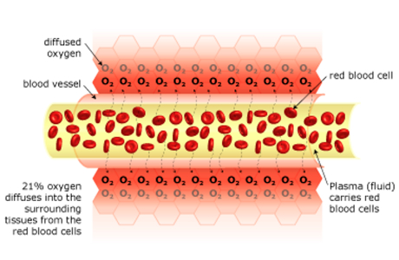
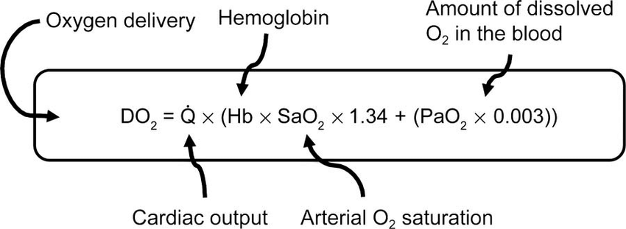
Why do we need oxygen?

Slide 4
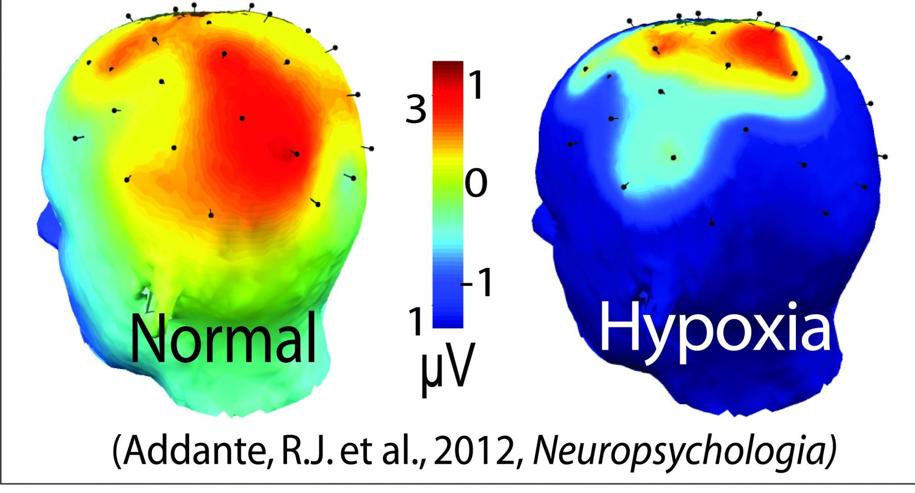

Slide 5
Causes of hypoxemia
V/Q mismatch
Shunt
Diffusion disorder
Alveolar hypoventilation
Altitude
Abnormal Hb

Slide 6
Special Patient Populations
CO2 retainers
Nocturnal vs continuous in severe COPD

Slide 7
Modes of Oxygen Delivery
Spontaneous respiration
Nasal cannula
High Flow
NIV
Mechanical ventilation
ECMO
Patient effort

Slide 8
Why High Flow?

Slide 9
What is high flow delivery?
What affects the volume of oxygen inhaled?
  Gas flow
  Concentration of oxygen from flow meter
  Inspired volume
  RR and VT
  Respiratory pattern

Slide 10
What is HFC delivery?
Requirements:
  Gas delivery system
  Humidification
  Heater
  Patient interface
    Cannula must accommodate 60LPM flow
    4mm-6.5mm diameter

Slide 13
What is HFC delivery?
Increased FIO2
CPAP effect
Comfort
Warmth /humidification
Improved mucociliary clearance

Slide 14
Int Care Med 2011; 37 (11): 1780-1786

Slide 15
Specific Diseases
COPD
OSA
High risk extubation

Slide 16
COPD

Slide 17
Burden of COPD exacerbation
COPD effects 1/10 globally
15M in US
3rd leading cause of death
13.2 billion in annual HC costs
COPD exacerbations causes worsening of underlying chronic condition and may increase mortality

Slide 18
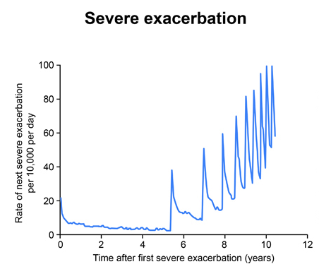
Chronic Obstr Pulm Dis. 2014; 1(2): 166-184

Slide 19
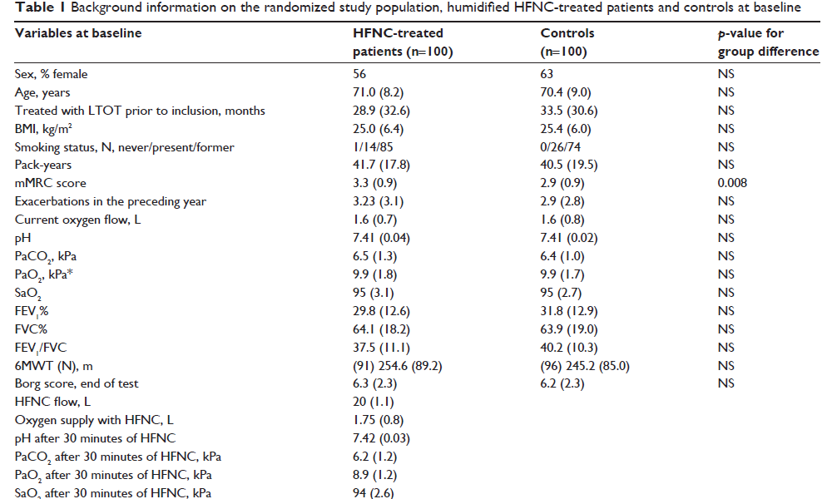
Outpatient HFC?
6.2 kpa=46mmHg
8.9kpa=66.8mmHg

Slide 20
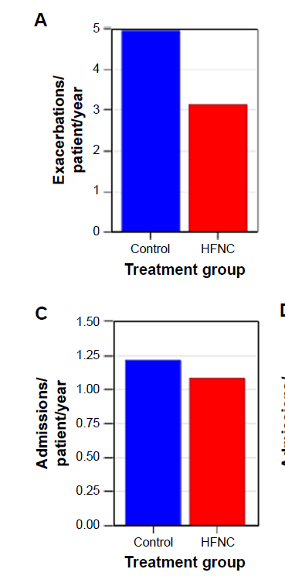
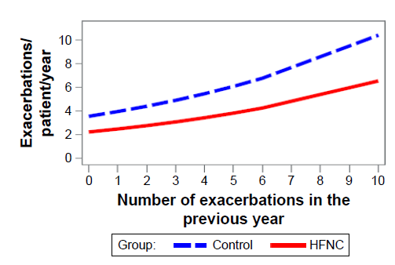

Slide 21
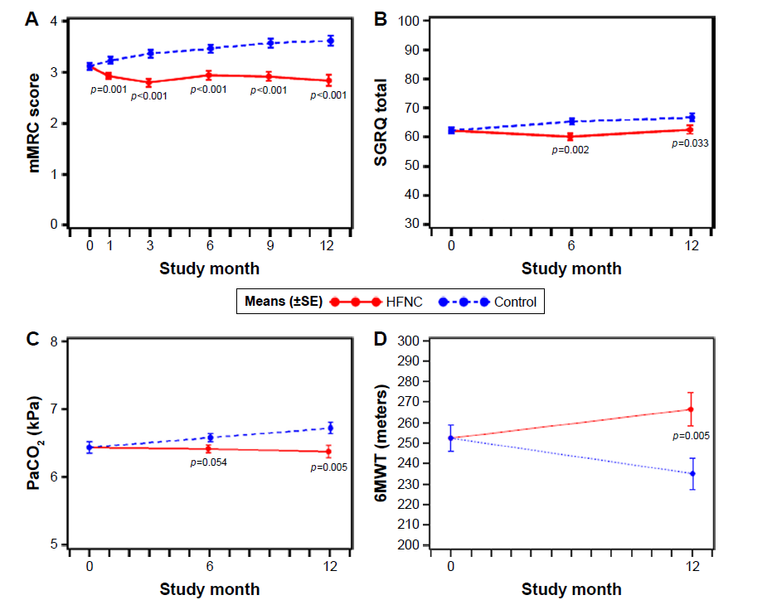

Slide 23
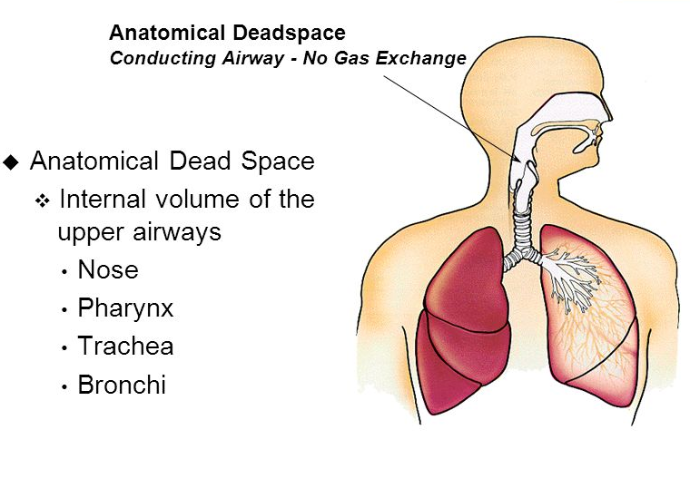
Why?

Slide 24
OSA

Slide 25
Positive pressure therapy remains standard of care

Slide 26
Compliance remains an issue…..

Slide 27
Could HFC delivery be an alternative to CPAP?

Slide 28
TNI: HFC delivery

Slide 29
Children?
Often associated with a broader medical syndrome
Therapeutic options
  Tonsillectomy
  Wedge
  Oral appliance
  Nasal steroids
  CPAP/BiPAP

Slide 30
HFC delivery in children

Slide 31
High risk extubation

Slide 32
Who is high risk?
Age > 65
APACHE II score > 12
BMI > 30
Airway patency problems
Secretions (suction > 2 x prior to extubation)
Difficult/prolonged wean
Prior failure
Co-morbid conditions

Slide 33


Slide 34
Is HFC superior to conventional oxygen therapy?

Slide 38
Conclusions
Oxygen is necessary
Multiple modalities of oxygen delivery tailored to the patient’s need and ability to participate
High flow nasal cannula is a unique delivery system that may help struggling patients “bridge the gap.”
High flow nasal cannula has applications in acute and chronic settings that may improve patient comfort, outcomes and morbidity
More studies are needed to define the role of HFC in treatment of the hypoxemic patient

