Slide 1
Myers Brigg Type Indicator (MBTI)
Debby Baydoun, MSEd, FASET,
REEG/EPT, RPSGT, RNCST, RST, CNCT
Assistant Professor of Neurodiagnostic Technology
Labouré College

Slide 2
Based on 50 yrs of research by
Carl G. Jung a Swedish
psychologist who studied
under Freud
Katharine Briggs- a self taught
psychological scholar (mom)
Isabel Briggs-Myers- worked
with her mom & developed the
MBTI further (daughter)

Slide 3
It is an indicator of a person’s
personality type.
The client answers pages of what
seems like inconsequential
questions. For example, pick one
word in each of the following pairs:
Concrete Abstract
Hearty Quiet
Reserved Talkative
Foundation Spire
Make Create

Slide 4
There are no right or wrong
answers, it is NOT a test.
The MBTI has 4 scales with 2
letters in each scale.
After completing the type
indicator, the client is left with 4
letters & a number each
representing a scale.

Slide 5
MBTI is used in many situations:
Marriage counseling
Counseling between teen/parent
Employee conflict
Teachers- to accommodate
different learners
Managers need to know which employee to send for the job at hand

Slide 6
Employee conflict is the #1 reason people are dissatisfied with their jobs!
You don’t have anyone in your lab that doesn’t get along with each other do you?

Slide 7
Get out a piece of paper and keep track of what you think your MBTI is as I go along.

Slide 8
The 4 scales
1st scale describes a person’s
attitude & where they like to
focus their attention or energy (inside or outside)
E for Extravert or
I for Introvert

Slide 9
Where is their interest & energy:
Extrovert Introvert
Active Reflective
Outward Inward
Sociable Reserved
Open Private
Many Few
Expressive Quiet
Breadth Depth

Slide 10
As a teacher, you need to understand their different learning needs:
Extroverts
Speeches
Play games.
Introverts
Term papers
Study guides

Slide 11
As a lab supervisor, you need to understand:
Extroverts
Get bored working on long project
Prefer working on things with
other people.
Introverts
Can work on same project for a
long time & not get bored
They like to work alone

Slide 12
2nd scale is how a person
prefers to take in
information (the perception
process)
S for Sensing or
N for Intuitive

Slide 13
Do they take in info using….
Sensor Intuition
Details Patterns
Present Future
Practical Imaginative
Facts Innovations
Sequential Random
Directions Hunches
Repetition Variety
Literal Figurative

Slide 14
As a teacher you need to:
Sensor
Class exercises
Structure
Demos
Intuitive
Surprises
Field trips
Shake it up

Slide 15
As a lab supervisor assign:
Sensor
Detail oriented projects such as
coming up with a more organized
filing system.
Intuitive
You need to assign imaginative
projects such as what will the
needs of our lab be in 10 years &
what do we need to do now to get
us there.

Slide 16
3rd scale describes how
someone makes judgments
T for Thinking or
F for Feeling

Slide 17
How do they make decisions:
Thinker Feeling
Head Heart
Objective Subjective
Justice Harmony
Cool Caring
Impersonal Personal
Critique Appreciate
Analyze Empathize

Slide 18
As a lab supervisor send:
Thinker
Reprimand someone
Analyze something
Feeler
Council someone
Hold the hand of the mother of a
sick child.

Slide 19
4th scale expresses the
lifestyle a person prefers and or
their perception or orientation
process
J for Judgment or
P for Perception

Slide 20
Does the person live:
Judgment Perception
Organized Flexible
Structure Flow
Control Experience
Deliberate Spontaneous
Closure Openness
Plan Wait
Deadline Discoveries

Slide 21
As a lab supervisor:
When a patient shows up on the
wrong day for their EEG, send the
perceptive to perform it, the judger
will not like that their schedule has
been changed.
If it is extremely important that a
project be done on time, ask the
judger to do it. The perceptive
hates deadlines & will put it off to
the last minute.

Slide 22
ISTJ | ISFJ | INFJ | INTJ
ISTP | ISFP | INFP | INTP
ESTP | ESFP | ENFP | ENTP
ESTJ | ESFJ | ENFJ | ENTJ

Slide 23
The number that goes with each
letter represents the amount of
?’s that were answered
toward that letter of the scale.
There is an odd number of
?’s relating to each scale so there
won’t be a tie. Say there were 31
?’s for the E/I scale. You may
have answered 15 as an E
& 16 as an I.

Slide 24
E’s tend to think I’s are withdrawn
& non-exciting & I’s think E’s are
shallow & talk too much.
S’s think N’s are fickle day
dreamers & N’s think S’s are too
routine & stuck in a rut.
T’s seem cold & condescending to
F’s & F’s seem fuzzy minded &
emotional to T’s.
J’s think P’s are disorganized,
unreliable & messy & P’s think J’s
are unbending, uptight & rigid.

Slide 25
It takes ALL kinds of personality types to run a successful business or a successful department:
You need the NP’s to come up
with ideas.
You need the IS’s to sit in their
office & crunch the numbers.
You need the SJ’s to organize the
set up of the new procedure.
You need the E to sell the idea to
the finance committee.

Slide 26
It is quite common for department
supervisors who are interviewing
for an open position in the lab to
pick the new employee based on
their own MBTI.
It is the same for program
directors who are interviewing
candidates for their program.
Both supervisors and teachers
need to understand the MBTI’s of
their employees/students to help
them get along.

Slide 27
STORY:
Supervisor who observed student interaction with employees during their clinical rotation to best pick who would fit in their lab.

Slide 28
TEST

Slide 29
What would happen if you asked a strong introvert to present a lecture at the next society meeting?

Slide 30
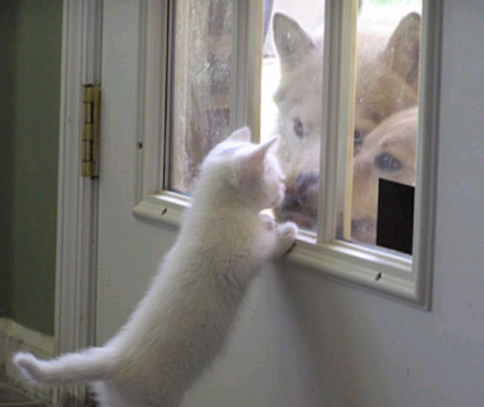

Slide 31
What would happen if you asked a strong extrovert to present a lecture at the next society meeting?

Slide 32
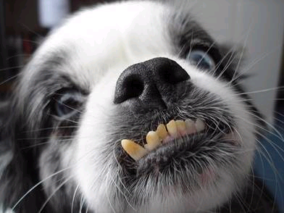

Slide 33
What would happen if you asked an ESTJ to change their schedule at the last minute?

Slide 35
What would happen if you asked an INFP to change their schedule at the last minute?

Slide 36
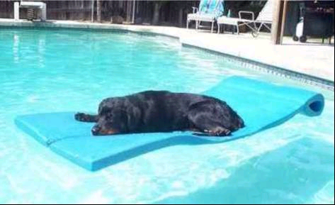

Slide 37
What would happen if you asked an ISTJ to sit in an office all day and run some numbers?

Slide 38
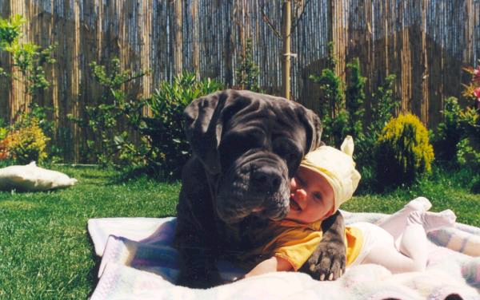

Slide 39
What would happen if you asked an ENFP to sit in an office all day and run some numbers?

Slide 41
What would happen if you asked a feeler to fire someone?

Slide 42
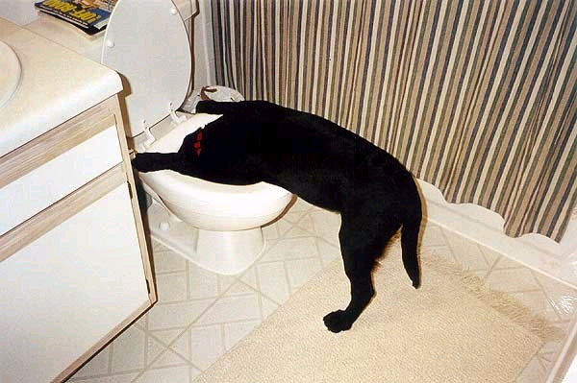

Slide 43
What would happen if an INFP made a mess after an ESTJ just spent all day cleaning?

Slide 45
What would happen if an ENTP interrupted an ISFJ while they were hard at work on a project?

Slide 47
What would happen if you asked an ISTJ how could we get a cow to ride a bicycle?

Slide 48
They would say, “you can’t get a cow to ride a bicycle, why would you even want a cow to ride a bicycle?”
They would respond by saying, “you can’t get a bear to ride a bicycle, why would you even want a bear to ride a bicycle?”

Slide 49
If you asked an INFP if they could get a cow to ride a bicycle they would respond…..

Slide 50
Anything is possible.

Slide 51
TAKE HOME POINTS
We all need to be aware of our
own MBTI & our own strengths
& limitations
We need to be aware of our
housemates, co-workers &
student’s MBTI’s so that we can
understand where they are
coming from

Slide 52
TAKE HOME POINTS
Ask your hospital’s conflict
resolution department if they can
administer MBTI. (may have
another name such as Firo-B)
Google MBTI & find web-sites it
will cost you anywhere from $25 to
$45 to find out what your MBTI is.

Slide 53
As department managers who
interview applicants for jobs or
program directors who interview
prospective students, we need to
NOT be bias by only selecting our
own MBTI type
We need to understand that it
literally takes all types for a
successful department

Slide 54
If we all understand each other’s MBTI type we can get along, no matter what species we are!

