Slide 1

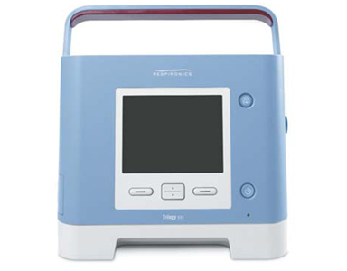
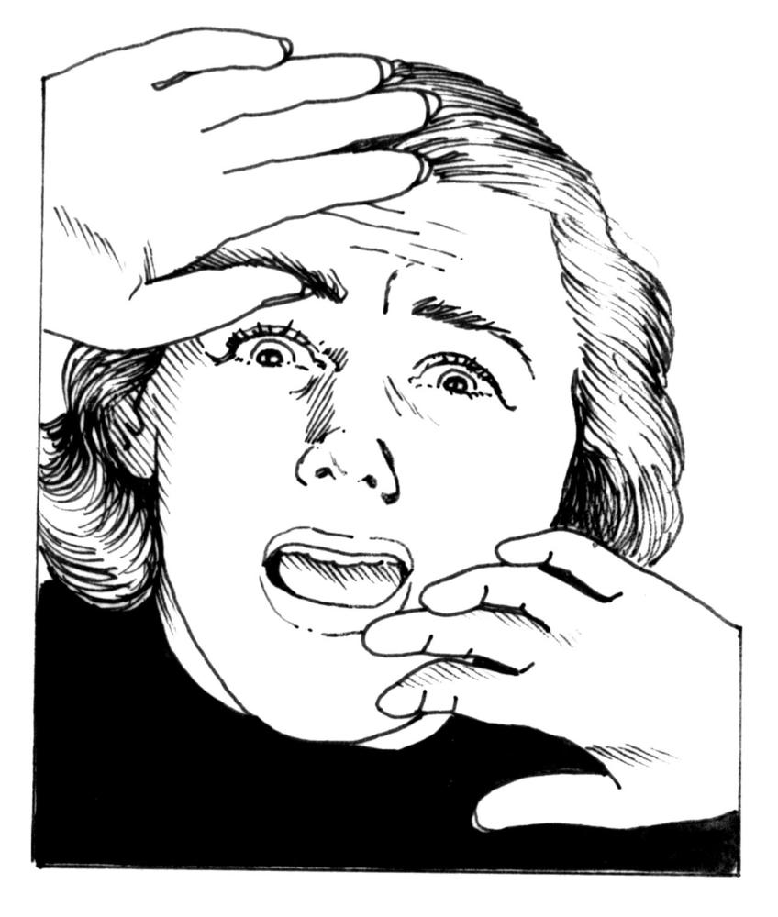
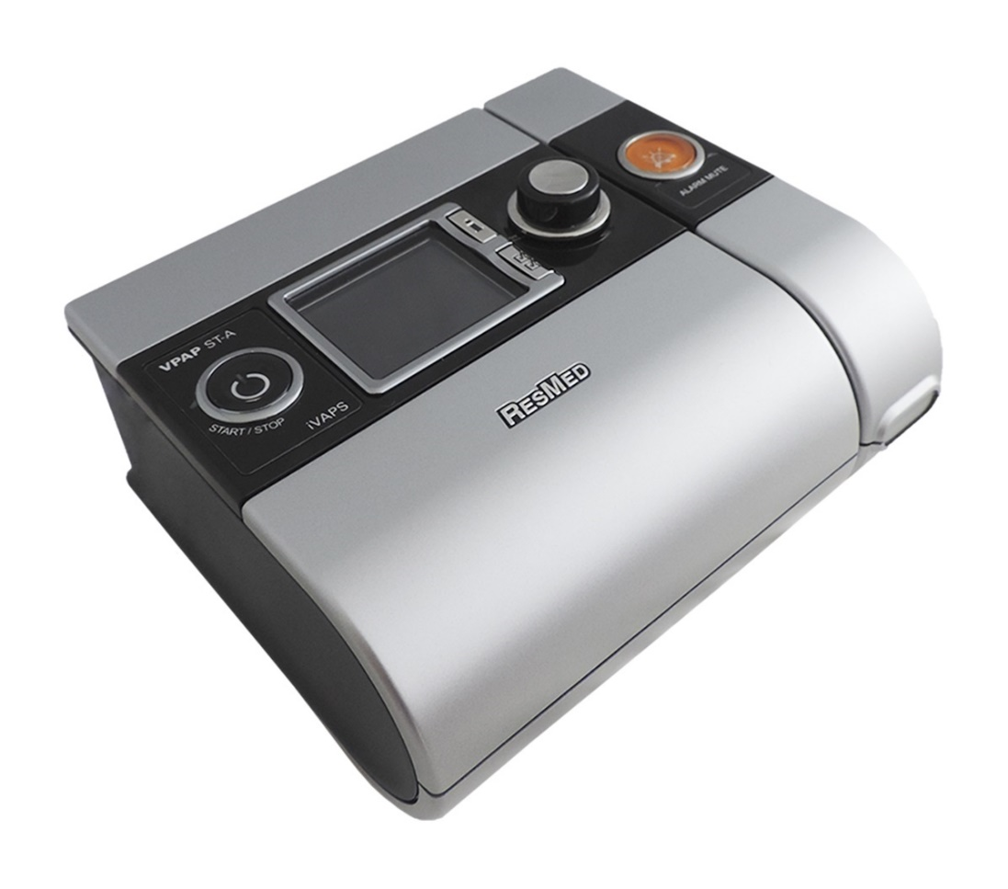
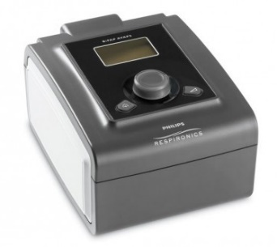
AVAPS
Aaron Roberts, MD
PPG Sleep Medicine
11/16/18

Slide 2
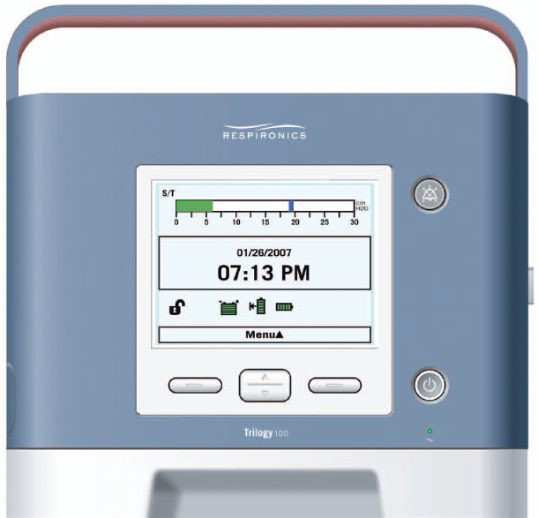
What Does AVAPS Stand For?
Automatic Ventilation Assured Pressure Support
Automatic Ventilation And Patient Support
Average Volume Assured Pressure Support
Average Volume And Patient Support
None of the above
I have no idea

Slide 3
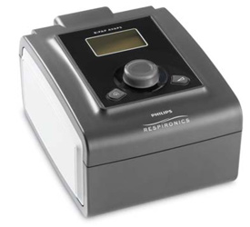
What Does AVAPS Stand For?
Automatic Ventilation Assured Pressure Support
Automatic Ventilation And Patient Support
Average Volume Assured Pressure Support
Average Volume And Patient Support
None of the above
I have no idea

Slide 4
Objectives
Overview of AVAPS
Review indications for AVAPS
Go through titration protocol
Troubleshooting
Q&A

Slide 5
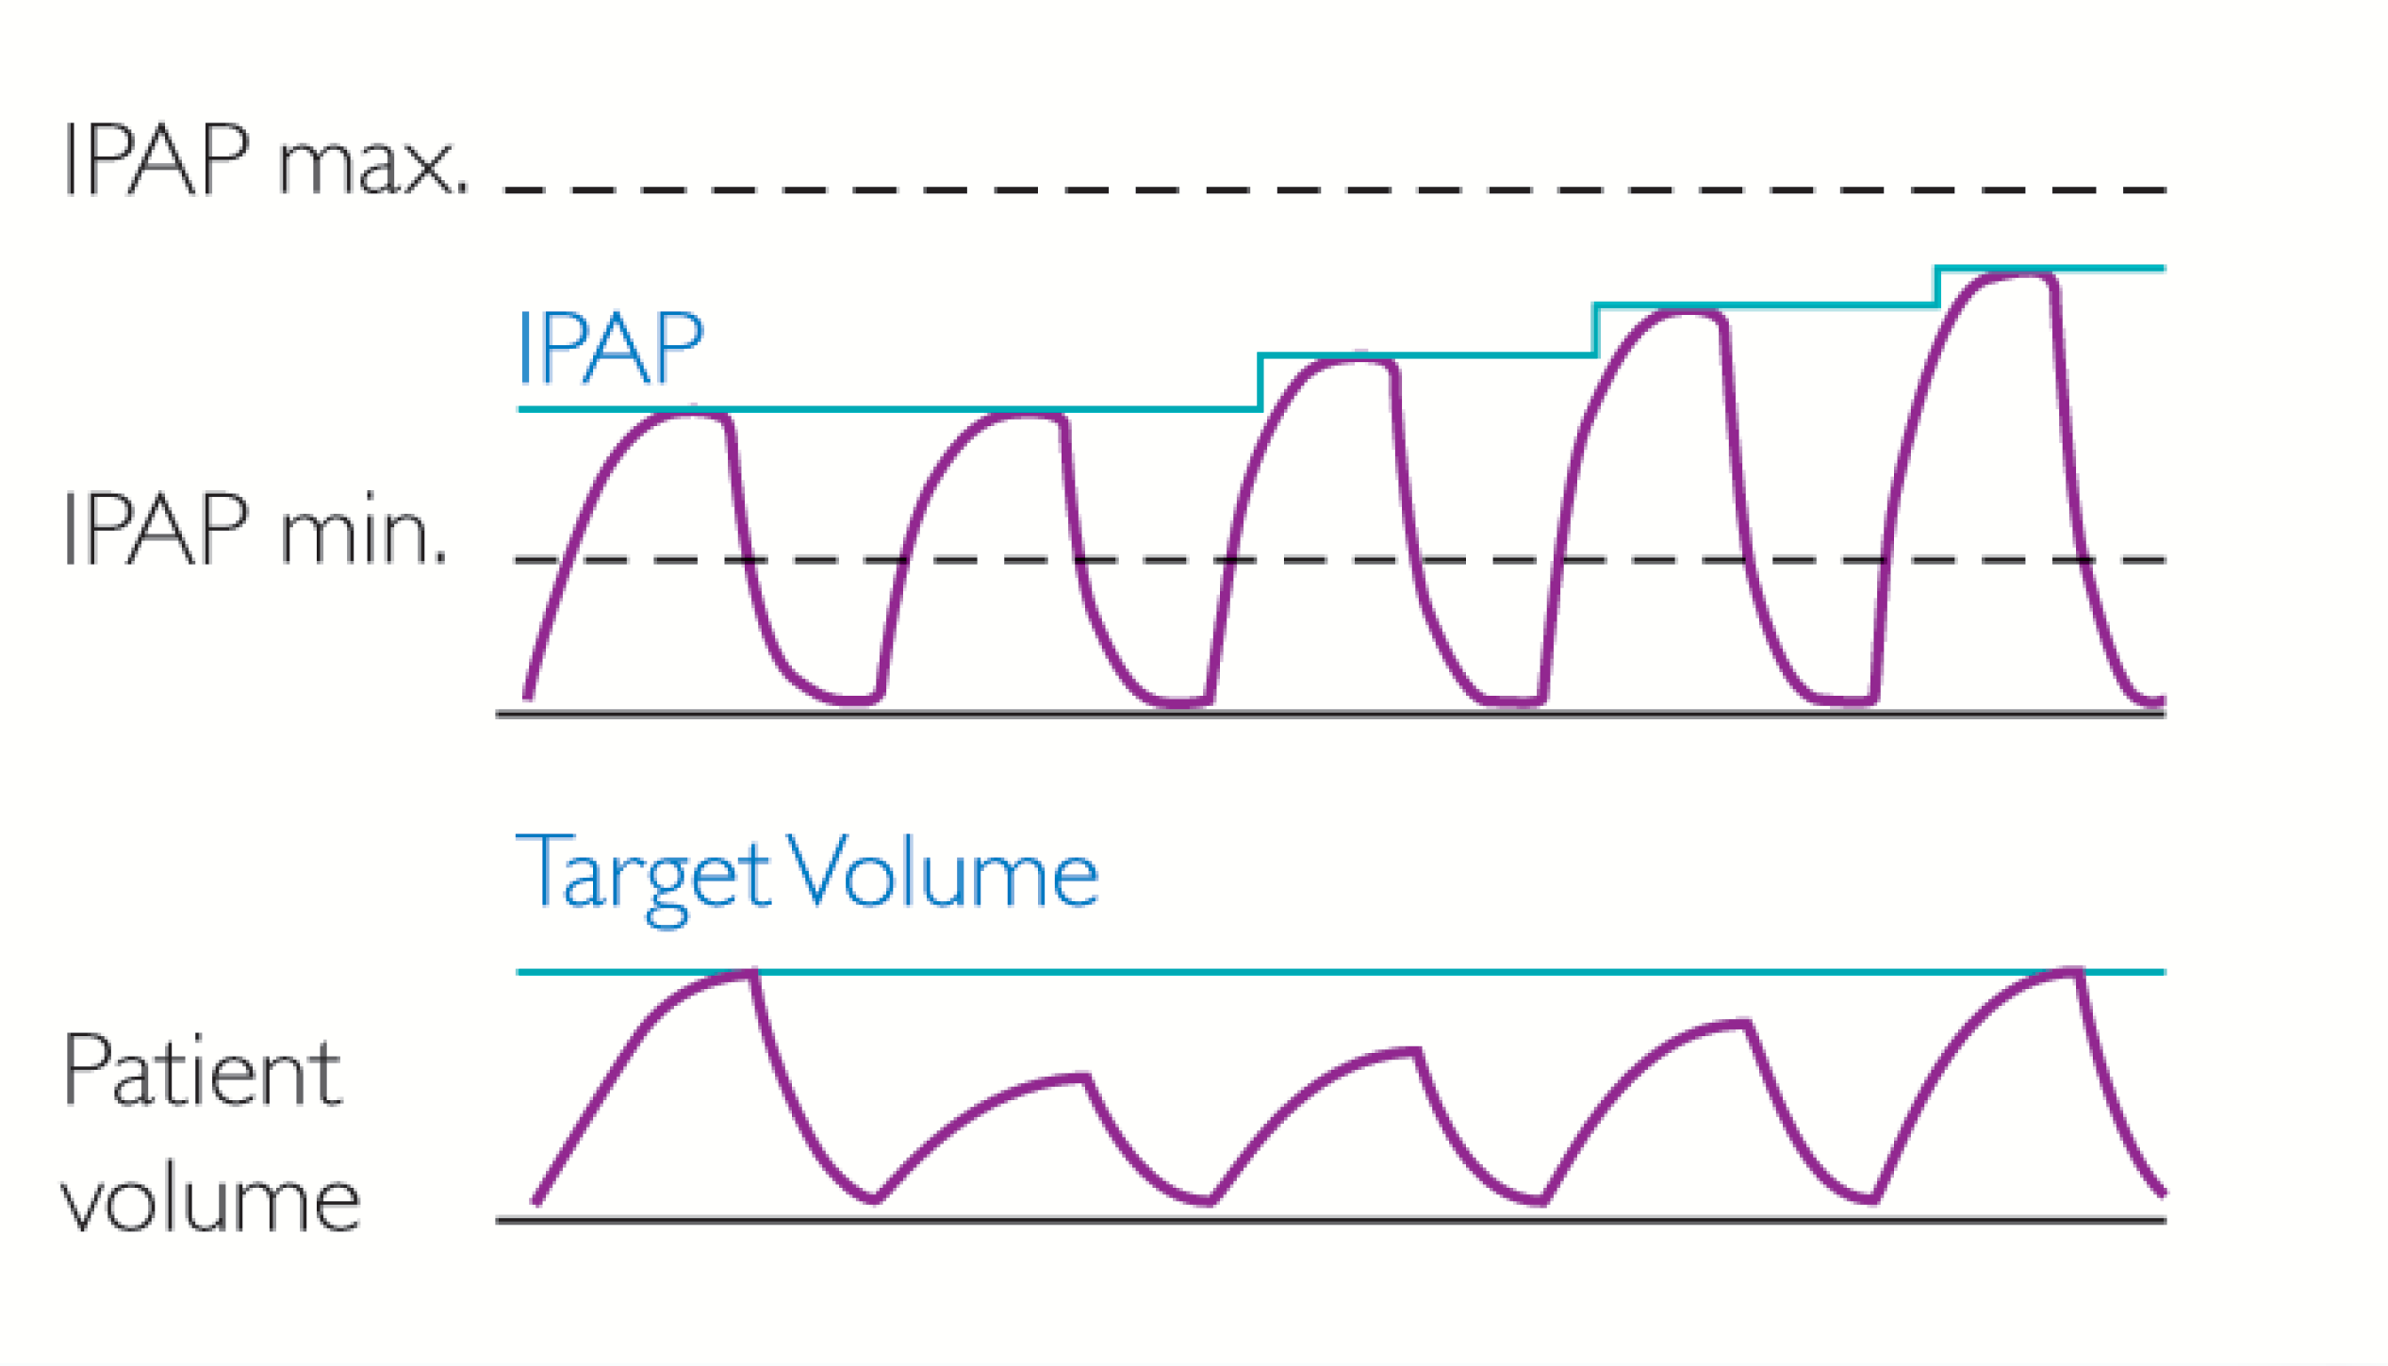
AVAPS; What is it?
Average Volume Assured Pressure Support

Slide 6
AVAPS: What is it?
Average Volume Assured Pressure Support
As name implies, it is simply volume targeted pressure support.
Auto titrating mode that responds in Inspiratory pressures to changes in thoracic dynamics to ensure stable tidal volume delivery.
Considered a “Hybrid” mode since it is both Pressure and Volume oriented mode of ventilation.
Also used as an ‘adjunct’ or added to other modes of ventilation such as “S” mode, “S/T” mode or even PC (Pressure Control) mode.
Allows clinician to set operating pressure limits for safety or diagnostic purposes.
Available in R.A.D. platform, but more fully developed in Trilogy Ventilator.
Also recently developed in new Omni-Lab Advanced titration device.
Notes:
AVAPS is a support function within pressure modes

Slide 7

AVAPS-AE: What Is It?
Auto-titration mode of noninvasive ventilation (NIV) designed to better treat respiratory insufficiency patients in the hospital and homecare environments
Proven performance of AVAPS
– Maintains targeted tidal volume
Auto EPAP
– Maintains patent upper airway
at comfortable pressure
Auto backup rate
– Applies an auto backup rate
near a patient’s resting rate
Notes:
I would like to introduce you to a new mode of NIV designed to treat most all of your respiratory insufficiency patients in either the hospital or the home environments.
The three main components to AVAPS-AE are:
AVAPS, Average Volume Assured Pressure Support – A proven NIV algorithm that allows you to volume ventilate a patient noninvasively using a pressure support device.
Auto EPAP – Airway obstruction is an important factor when considering to noninvasively ventilate a patient. Philips Respironics has been treating patients diagnosed with airway obstructions with these algorithms for more than 20 years and now we are bringing it to you in a NIV device.
Auto backup rate – The auto backup rate allows the BiPAP A40 to determine the appropriate rate for the patient. The resulting rate is similar to what clinicians have been doing for years to determine an appropriate back-up rate for a patient.

Slide 8
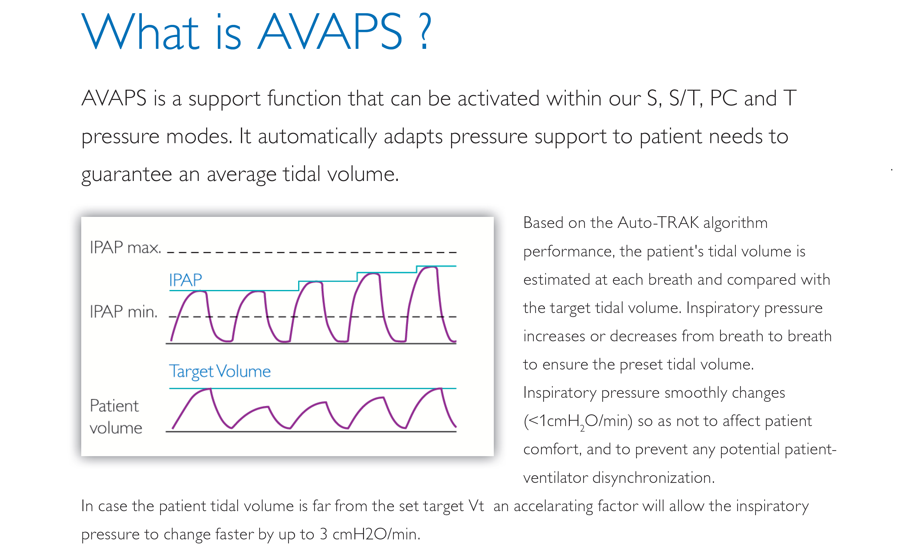

Slide 9
AVAPS-AE: Why do we need it?
Goal: Provide consistent tidal volume delivery resulting in a patent airway along with a comfortable and automated backup rate.
Pressure Support ventilation alone cannot provide consistent tidal volumes
  – AVAPS continuously titrates PS to maintain targeted tidal volume
EPAP requirements to maintain airway patency can change
  – AVAPS AE continuously titrates EPAP and automatically adjusts to maintain airway patency
Auto backup rate
  – Designed to provide a auto backup rate based on patient’s spontaneous respiratory rate to support comfortable sleep
Pressure support ventilation is accepted by patients and can be adjusted for patient comfort. AVAPS-AE allows the patient to breath spontaneously whenever they want and is very forgiving of leaks due to the available triggering technologies (Auto-Trak, Sensitive Auto-Trak and Flow Triggering). The achilles’ heel of Pressure Support is that it does not provide a consistent level of ventilation…the pressure is consistent, but the volume is not. AVAPS-AE can fill this potential therapy gap by adjusting the Pressure Support level to keep the targeted tidal volume in sight.
Auto EPAP solves an unfulfilled need for NIV therapy. Patients who need NIV are no different than patients who have OSA. They all have the potential for varying degrees of airway obstruction. You could titrate their EPAP to a level that corrects all of their OSA events, but that could be a very high level that they don’t need all the time. If you add the higher levels of PS that a ventilation patient needs, the total could be a very high pressure that is uncomfortable to a patient. An Auto EPAP solution can allow the same level of airway patency at lower mean EPAP pressures that can translate into more comfort for the patient.
Auto backup rate is a very simple solution to providing a backup rate for your patient. It essentially counts the spontaneous rates just like you would and sets the rate based on the patient’s rate. It also provides for some flexibility around that rate if the patient is breathing spontaneously, which should be more comfortable for the patient.

Slide 10

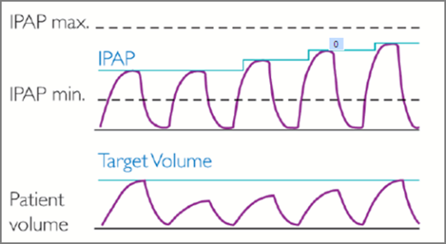
AVAPS: Proven Effective
Automatically titrates pressure support
  Changes in body position
  Sleep stage
  Changes in respiratory mechanics
Delivers average tidal volume
  Throughout course of the night
  Long-term progression = protects/defends resting lung volume
AVAPS produces results comparable to sleep lab titration of PS¹
  CO₂ reduction
  Health-related quality of life
  Sleep quality
¹Murphy, PBThorax thoraxjnl-2011-201081: Published Online First: 1 March 2012 doi:10.1136/thoraxjnl-2011-201081

Slide 11
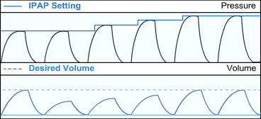
Improved Patient Care is Now Automatic
AVAPS Feature
What It Does:
  Automatically adapts pressure support to maintain a targeted tidal volume
Why It Matters:
  Automatically adapts to disease progression and changing patient needs
  Improves ventilation efficacy
  Simplifies the titration process

Slide 12
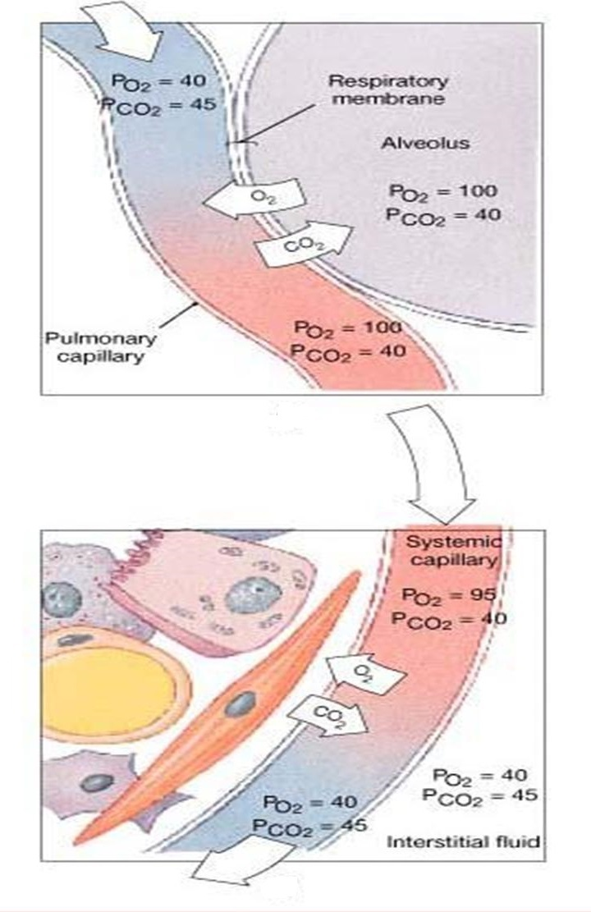
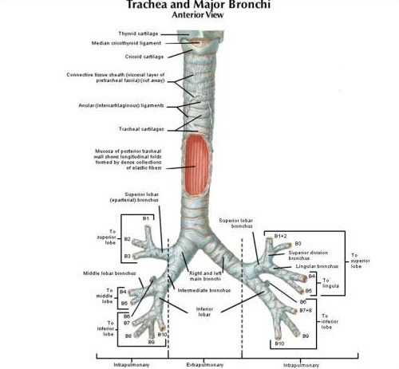
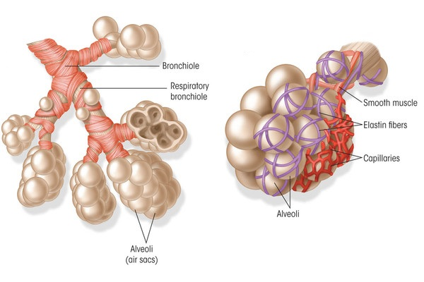

Slide 13
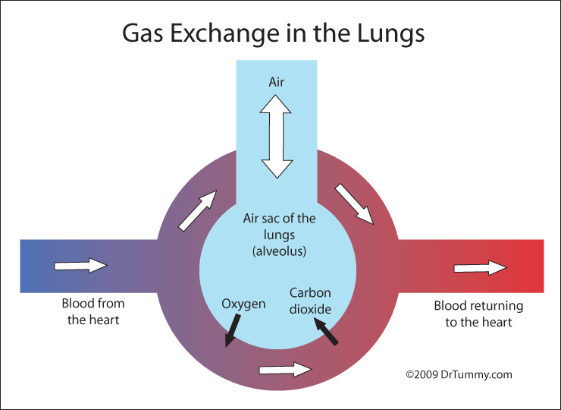
What Does AVAPS Do?
Provide consistent Tidal Volume (V_{t})
Volume targeted pressure ventilation (AVAPS)
Consistent CO₂ elimination
Notes:
Strategy: Improve Ventilation

Slide 14
What Does AVAPS Do?
Targets alveolar ventilation to deliver required ventilation at the alveoli, where gas exchange occurs. Unlike other volume-assurance modes, AVAPS maintains the alveolar target even when RR changes.
Setting alveolar ventilation targets the patient’s true ventilation requirements and represents a more accurate approach.
It’s able to deliver the required ventilation at the alveoli, where gas exchange occurs, by taking into account and compensating for the portion of air that travels through the conducting airways.

Slide 15
Pressure Modes
Spontaneous (S) | Therapy mode in which breaths are taken by the patient. The ventilator supports breathing with user-defined Pressure Support (PS) and Rise Time values.
Spontaneous Timed (S/T) | Therapy mode that is similar to S mode, except that it can also deliver a mandatory breath if the patient does not spontaneously breathe within a set timeframe.
Timed (T) | Therapy mode where all breaths delivered are mandatory.
Pressure Control (PC) | Therapy mode that delivers assisted and mandatory breaths with a user-defined pressure.
Notes:
Trilogy has 6 pressure modes.

Slide 16
Pressure Modes
Spontaneous (S) | Therapy mode in which breaths are taken by the patient. The ventilator supports breathing with user-defined Pressure Support (PS) and Rise Time values.
Spontaneous Timed (S/T) | Therapy mode that is similar to S mode, except that it can also deliver a mandatory breath if the patient does not spontaneously breathe within a set timeframe.
Timed (T) | Therapy mode where all breaths delivered are mandatory.
Pressure Control (PC) | Therapy mode that delivers assisted and mandatory breaths with a user-defined pressure.
Notes:
Trilogy has 6 pressure modes.

Slide 17
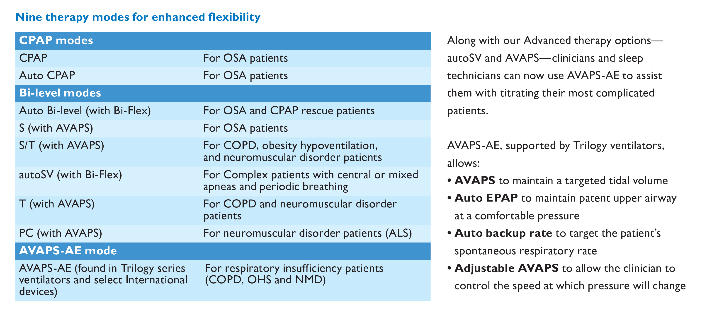

Slide 18
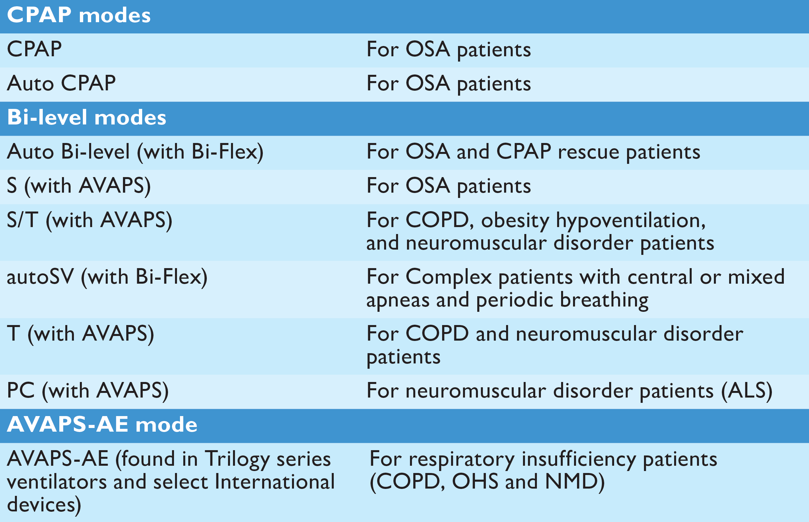

Slide 19
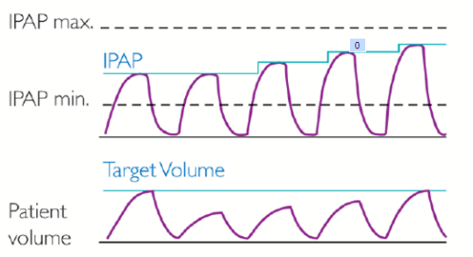
BiPAP AVAPS Enhancements
Flexible
  Clinicians can now select AVAPS rate of change from 1.0 to 5.0 cm H₂O of pressure based on patient need
Stable V_{t}
  AVAPS now tracks spontaneous and timed breaths separately
  Applies correct amount of pressure support to each breath type
Accurate
  Enhanced leak estimation algorithm in Trilogy
  Better leak estimation means better V_{t} tracking and targeting

Slide 20
AVAPS Algorithm Overview – How Does it Work
Notes:
Initial IPAP
IPAP_{start} = Vt_{target} / 60 + EPAP
During the first minute, AVAPS does not change IPAP and blocks the low tidal volume alarm
The average tidal volume is measured over a one minute period
AVAPS calculates the required IPAP change after each breath
The maximum IPAP change is 1 cmH2O/min for stable patients

Slide 21
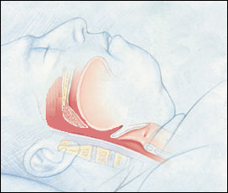

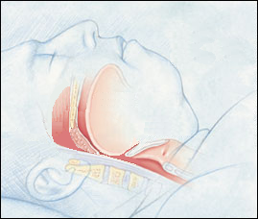


AVAPS-AE: Auto EPAP Proactive Analysis
Theory of Operation
Device Pressure
P search
opt
P
therapy
crit
P search
Upper Airway Resistance
Illustration courtesy of Krames Medical Illustration.
Notes:
The easy way to implement an auto device of any kind it to do the “wait then react” technique. Wait for an event to occur and then react to it by raising the pressure. That way allows events to occur first and then it tries to fix them. We think the proactive method can reduce some of those events that drive other algorithms.
This slide graphically illustrates the method used in our proactive searches for therapy pressure for EPAP. If you watch the picture at the left you can see initially that the airway is shown to be occluded. As pressure is gradually increased to the airway initially it remains occluded with very high airway resistance.
When enough pressure has been applied to the airway the airway opens and resistance drops sharply.
With continued increases in pressure the resistance changes become very small.
This is the area we call Popt or optimized pressure.
At this point the device will stop adding pressure to avoid unnecessary and uncomfortable pressure increases.
The device will hold pressure at this level until the next search phase.
The next search will be with gradual pressure decreases looking for the critical pressure boundary where small pressure decreases cause large changes is resistance.
This is what we call the Pcrit or critical pressure area.
The idea behind the proactive searches is to keep the pressure in a therapeutic range between the critical and optimal pressure areas, providing the lowest pressure needed for airway patency throughout the night.

Slide 22
AVAPS-AE: Auto EPAP Proactive Analysis
Popt – Optimal Pressure Search
(High Pressure Search)
P
opt
Pressure
P
Popt
ther
EPAP
P opt
P
P opt
P therapy
P crit
crit
P therapy
Critical Pressure Searches
(Low Pressure Search)
Resistance
P therapy
P therapy
P opt
P crit
EPAP
P crit
Pcrit
Notes:
This illustrates the proactive nature of our auto EPAP algorithm.
The device will proactively increase EPAP pressure to evaluate the impact the increase has on the airway.
This AVAPS-AE is seeking the optimum pressure or conducting a Popt search.
AVAPS-AE will do this until the pressure changes have no improvement on the airway.
At that point, AVAPS-AE will restore the pressure to the level prior to the last change and it will then search downward on the next cycle.
This is called a critical pressure search or Pcrit.
The Pcrit search will lower pressure gradually until the airway patency starts to decrease.
At that point the device will reverse the last pressure decrease and then repeat the process by conducting a Popt search next.
This method allows the algorithm to anticipate the changing EPAP pressure needs before an obstructive event occurs.

Slide 23
Auto EPAP Today
Patient type | Treatment / Device | Pressure support requirements
OSA | CPAP/REMstar Auto | Low to none
Cardiac | Servo-Ventilation / BiPAP AutoSV | Dynamically applied pressure support
Respiratory insufficiency | AVAPS-AE / Trilogy, BiPAP A40 | High levels of pressure support
Notes:
So, why did we change the way we detect airway obstruction?
The difference is not how the airway responds to pressure, but rather what else we are doing with the device in regards to pressure support.
It starts with the type of patients we are treating. Patients with sleep disordered breathing can benefit from having an auto titrating CPAP or BiPAP device, but often they can be treated with a simple CPAP device.
The BiPAP AutoSV is intended for periodic breathing patients that have rapidly changing pressure support requirements.
The BiPAP AutoSV is capable of changing pressures from breath to breath by as much as 5 cm of pressure, but it typically delivers pressure support less than 10 cm of water.
Chronic hypoventilators typically need higher levels of pressure support, sometimes much higher than what is needed by a patient who is using BiPAP AutoSV.

Slide 24
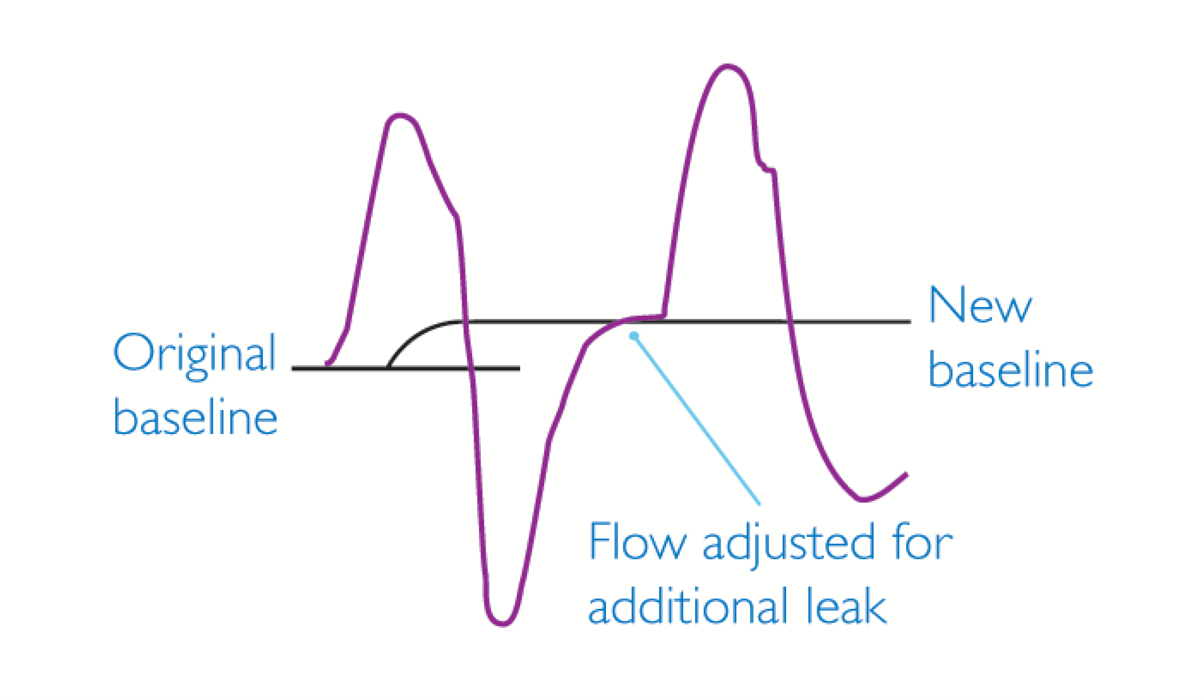

Slide 25
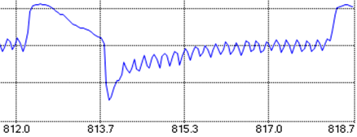
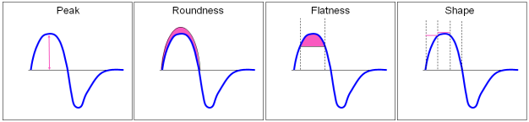
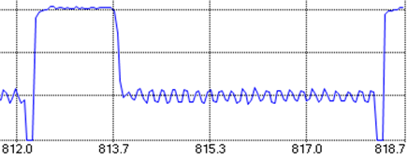
Comparison of Auto EPAP methods
Current PRI Auto EPAP/CPAP
AVAPS-AE
Flow
Peak
Flatness
Shape
Roundness
Pressure
Forced oscillation technique (FOT) at 5 Hz, 1 cm amplitude during EPAP
Notes:
On the left is our current method of evaluating the airway in sleep therapy devices. We look for subtle alterations in the inspiratory flow waveform to indicate whether the airway is obstructed or not. We look at the waveform and evaluate the peak, roundness, flatness, and shape.
For respiratory patients, our new method for an auto EPAP in AVAPS-AE is on the right. In the AVAPS-AE device, we use FOT (forced oscillation technique) to measure the airway resistance. The FOT signal is delivered at 5Hz, using a 1 cm amplitude sinusoidal signal. This resistance measurement is used instead of the flow waveform signal to determine if pressure changes result in improvements to airway patency.
Simply put, the pressure oscillations will cause flow oscillations. If the airway is obstructed, the flow oscillations will be smaller than they would be if the airway was patent. This is very similar to the pressure pulse we use to detect a “closed” or “open” airway on our CPAP devices. FOT has been used to measure resistances for many years and is in use on several other devices in the medical industry.
So, why did we change from the flow limitation method?
It goes back to patient type and the amount of pressure support that these patients need. Patients on NIV devices sometimes need very high levels of PS and this influenced our ability to detect airway obstruction based on the patient’s inspiratory flow pattern.
The PS was tending to normalize the flow pattern when it was delivered at higher levels. FOT enables accurate measurement of airway resistance in patients who need high levels of PS.

Slide 26
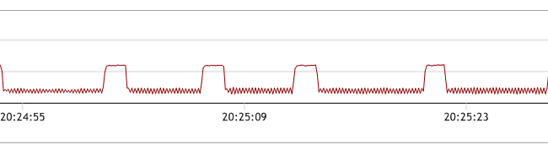
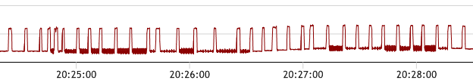
Benefits of FOT
FOT improves detection of obstructed airways at higher pressure support levels
  Not affected by high levels of pressure support
  FOT measurements taken at end exhalation (10 breaths)
R
R
R
R
Increase in EPAP by 1 cm H₂O s
Notes:
This is how the FOT is applied (supplied from DirectView software).
(Top image) The R point indicated the point in the breathing cycle where and when the resistance value is recorded.
FOT is applied before a search starts to get a baseline reading and then after the pressure increase has occurred.
The algorithm tracks the resistance from the cycle point to the trigger of the next breath.
When the next breath is triggered, the algorithm will look back ~ 100 milliseconds and use that point for R calculation as long as the breath has not been excluded from calculations.
The algorithm will also reject a breath that has a large change in leak breath to breath.
(Bottom image ) Here you can see instances where FOT is occurring.
(Bottom image ) There are ~ 14 breaths there before FOT stops.
This means that 4 of the breaths were rejected before the required 10 were obtained.
The bottom images reflect a Popt search. If you look closely you will see the initial baseline FOT measurement.
Then over 5 breaths the pressure increases 1 cm.
Then there is another FOT period where the resistance is again measured and then
compared to the previous resistance value.
The algorithm will then test the airway to see if resistance changed or stayed the same.
FOT improves detection of obstructed airways at higher pressure support levels not affected by high levels of pressure support; rejects variable leak breath to breath (>15%); FOT measurements taken at end exhalation (10 breaths).

Slide 27
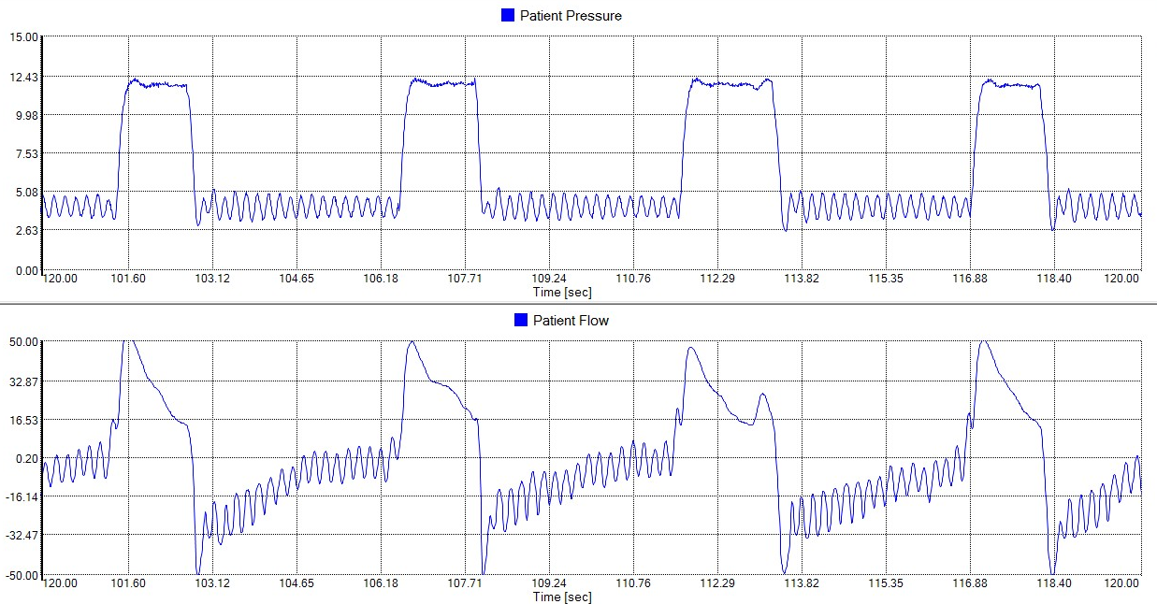
FOT – Flow resulting from pressure
FOT signal
Resulting flow

Slide 28
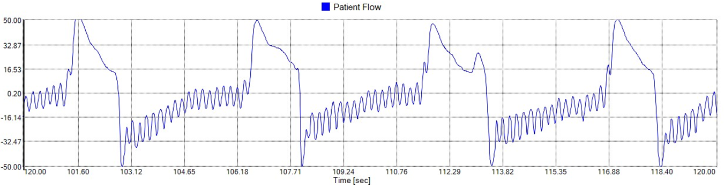
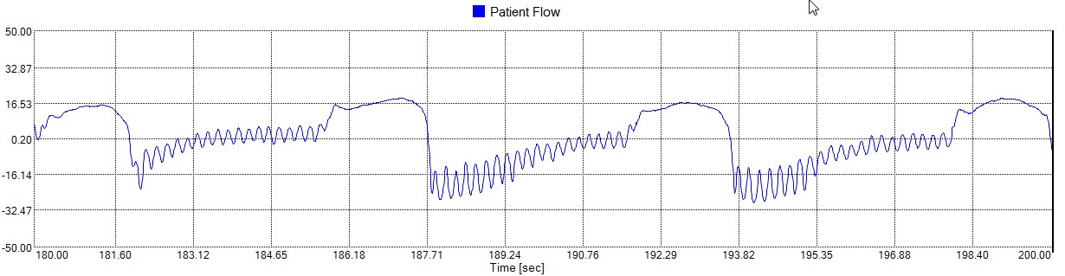
FOT – Patent vs. Obstructed Airway
Patent/Normal airway
Resulting flow (low resistance)
Obstructed airway
Resulting flow (higher resistance)
Notes:
Images compare the amplitude of the flow signals that result from the pressure oscillations in normal or patent airway vs. an obstructed airway.

Slide 29
Maintaining Tidal Volume and Airway Patency
PS max
EPAP max
PS min
IPAP
EPAP min
EPAP
Target Vt
Resistance
Notes:
What does AVAPS –AE do for the clinician?
It is like sending a skilled therapist into the patient’s room with orders to titrate the pressure support for a specific tidal volume.
At some point, the therapist will have to leave the room. When they do, you can’t be sure what tidal volumes are going to be delivered.
But in this case the therapist never takes their hand off of the pressure support knob.
They never leave!

Slide 30
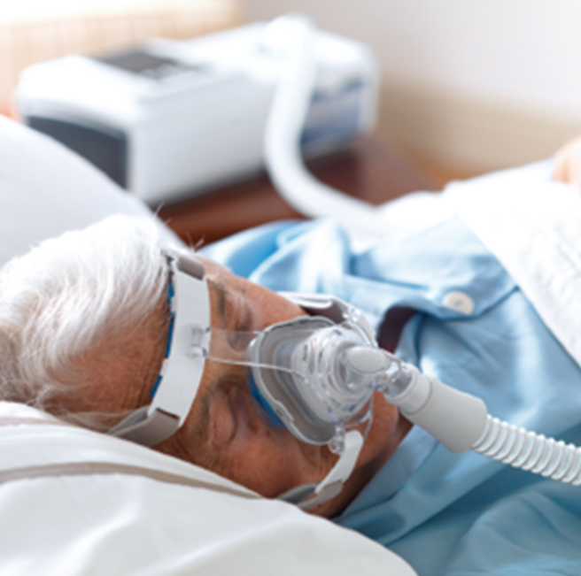
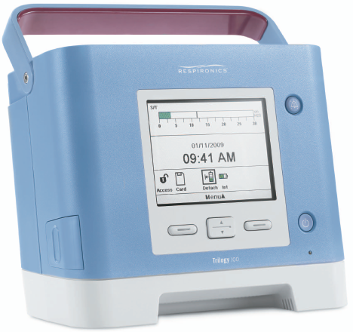
Auto Back-up rate
Auto Backup Rate
• Auto backup rate is near resting rate
• Comfortable assistance when needed
• No manual adjustments
(auto-default setting)
Auto backup rate combined with the tidal volume assurance of AVAPS provides a minimum level of ventilation
Notes:
• Auto backup rate is near resting rate
> Near spontaneous rate
> Minus 2 resting rate
• Comfortable assistance when needed
• No manual adjustments required (auto-default setting)
• Can define a rate if a specific rate is desired or it can be set so that there is no backup rate
which is the same as spontaneous rate

Slide 31
Auto Backup Rate
Targeted auto backup rate is 2 bpm below avg. spontaneous rate
Bpm
Calculated spontaneous rate
Target auto backup rate
Moving breath rate
10
Minimum auto
backup rate
Spontaneous breaths
Time 50 spontaneous breaths
Notes:
The auto backup rate for AVAPS-AE will average the breath times over a 50 spontaneous breath rolling window (Array) over the 1st hour and use the highest 50 average value of spontaneous breaths to calculate the patient’s spontaneous rate.
The algorithm will continue to monitor the spontaneous breath times after the first 50 breaths and if the spontaneous rate increases during the 1st hour of use each night, then the rate will be updated to the higher rate.
Lower spontaneous rates will not update the rate.
Once a spontaneous rate has been determined, the unit will update the backup rate to 2 bpm less than the spontaneous rate.
The lowest auto backup rate is approximately 10 and the highest is 20, however the patient can breath more than 20 breaths per minute.
If a higher rate than 20 or rate less than 10 is required, then the clinician can turn off the auto function and set a desired rate or turn off any machine-delivered rate.

Slide 32
Auto Backup Rate
The buffer is reduced by timed triggers
The patient will be guided back to the targeted backup rate
The auto backup rate is buffered by spontaneous triggers to promote synchrony with the device
Bpm
Target auto backup rate
Moving breath rate
10
Auto backup rate
buffer zone
Timed Breaths
Spontaneous Breaths
Time (Night time session)
Notes:
Once the auto backup rate has been determined by AVAPS-AE with 50 spontaneous breaths it will then maintain the patient near this rate for the remainder of the night (the patient can always go higher than this rate).
So, as seen here in the first few breaths, the rate is delivering the auto backup rate because the patient is not triggering breaths. If the patient starts to trigger breaths above the auto backup rate, the algorithm will promote synchrony with the vent by allowing some flexibility with the rate.
As the patient continues to trigger more spontaneous breaths, the rate may be suppressed by as much as 25% of the spontaneous rate. If the spontaneous rate is 18 bpm, that would set the target rate at about 16 bpm. The lower limit of the comfort buffer zone will now be 25% below the rate of 18 bpm. So the lower limit of the comfort zone is ~ 13.5 bpm. 16 bpm is an interval of about 3.8 seconds between triggers. 13.5 bpm is about 4.4 seconds between triggers. This means that if the patient has been breathing spontaneously and has developed the full amount of buffer they will be allowed to take a spontaneous breath as long as 4.4 seconds apart. If the patient fails to trigger after 4.4 seconds they will get a timed breath from the device and the amount of comfort zone buffer will be reduced. If the patient continues without triggers the rate will slowly bring them back to the target within one minute.
Remember….Spontaneous triggers add to the buffer zone (up to the max of 25% below the spont rate) and timed triggers will reduce it.

Slide 33
Auto Backup Rate: Patient Comfort Features
Comfort feature intent: Minimizes patient/device asynchrony
Rate will not exceed patient’s initial resting spontaneous rate
Machine breath delayed if patient is still exhaling
AVAPS-AE allows patient to terminate a machine delivered breath

Slide 34

Indications for AVAPS

Slide 35
AVAPS-AE: Who It Treats
AVAPS-AE is used for patients with complex breathing disorders with or without OSA component who suffer from Minute ventilation instability. Etiology can stem from Hypoventilation syndromes to airflow limitation related to obstructive pulmonary disease. Patients with dynamic I:E ratios and chronic parenchymal disease with limited reserve lung volumes can benefit from the auto rate feature alone.
Many of these patients primarily have COPD and some Hx of Chronic Respiratory Failure who may be underserved by traditional sleep therapy modes & methods.

Slide 36

Which Patients Are Suitable For AVAPS?
Obesity hypoventilation syndrome (OHS)
Restrictive disorders (kyphosis or pulmonary fibrosis)
Neuromuscular disorders and SDB
Severe COPD with chronic respiratory failure
Opioid-induced central sleep apnea
Periodic breathing (Cheyne-Stokes)
A, B, C, and D
All of the above

Slide 37
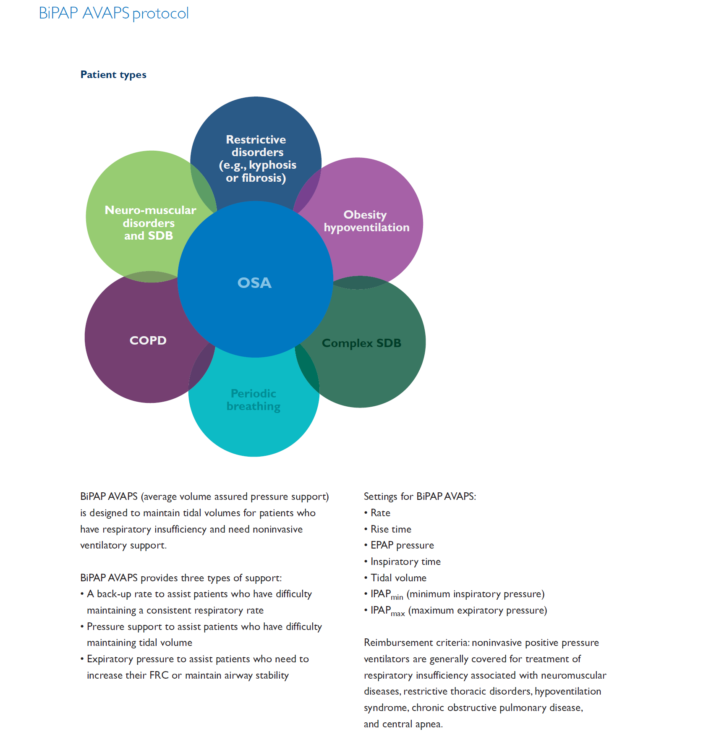

Slide 38
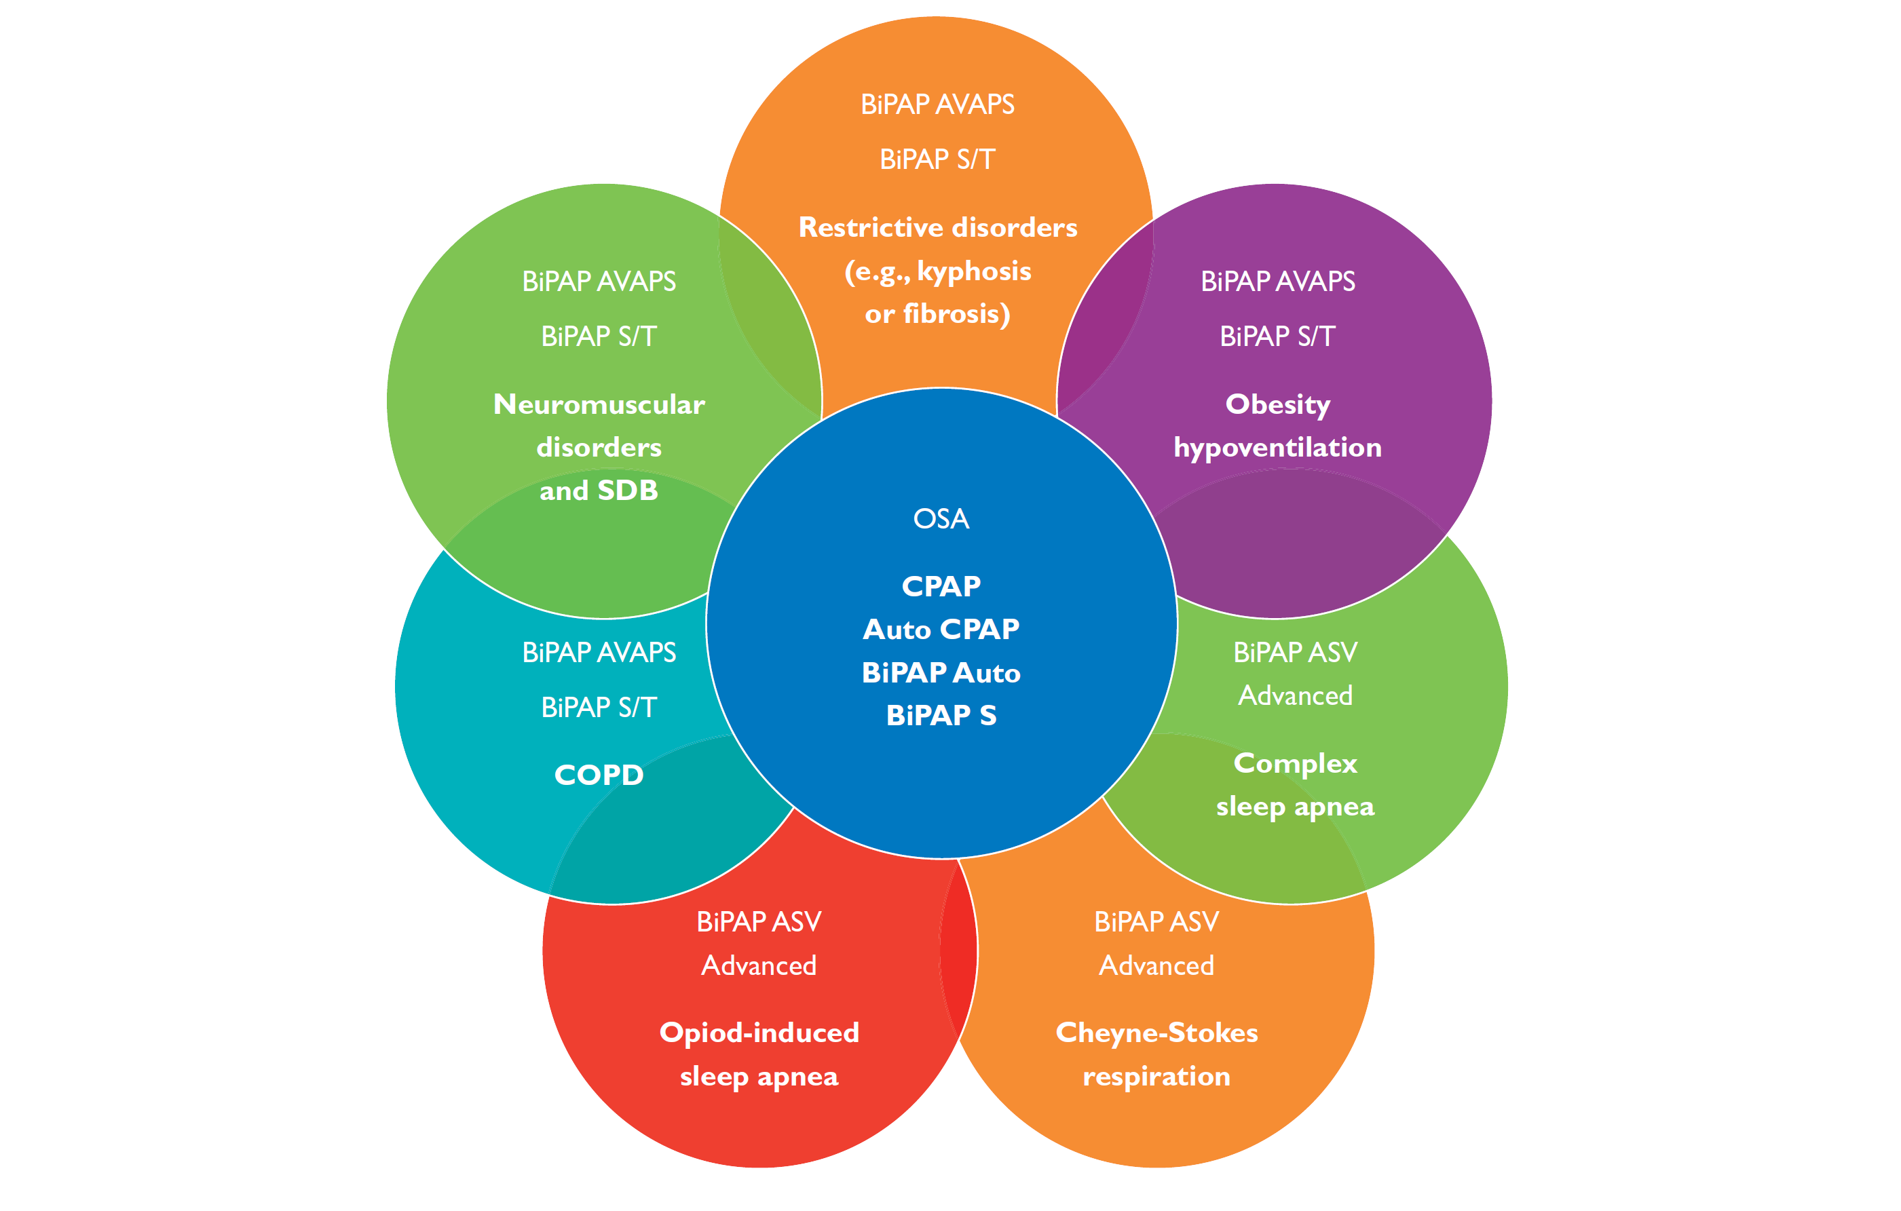
Notes:
AVAPS is a ventilation device for patients with respiratory insufficiency
29% to 40% of COPD patients have OSA¹
90% of OHS patients have OSA²
¹Jelic International Journal of COPD 2008:3(2)269-275
²Mohklesi. Chest 2007:131;1624-1626

Slide 39
Chronic obstructive pulmonary disease (COPD) — AVAPS may reduce the risk of hyperinflation associated with increased respiratory rate, as compared to therapy targeting tidal volume
Neuromuscular disease and restrictive conditions — AVAPS can maintain stable ventilation when respiratory effort fluctuates
Obesity hypoventilation (OHS) — When compared to standard Pressure Support therapy, AVAPS can compensate for changes in respiratory mechanics, such as during nocturnal changes in the patient’s body position
Notes:
iVAPS is suitable for adults with respiratory insufficiency. It is ideal for patients whose condition is likely to change and is characterized by hypoventilation (day/night hypercapnia).

Slide 40

Absolute Hypoventilation
Overlap disease
Obesity Hypoventilation Syndrome
Neuromuscular Disease
CO₂ retention

Slide 41
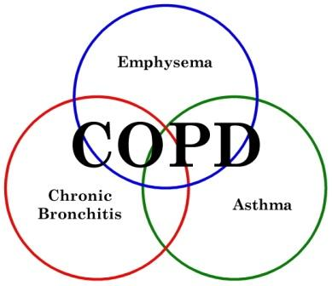
COPD Overlap Syndrome
Combination of OSAHS and COPD
Usually more significant O₂ desaturation
More likely to develop pulmonary hypertension
CO₂ retention due to hypoventilation
Decrease in O₂ levels are very evident on PSG

Slide 42
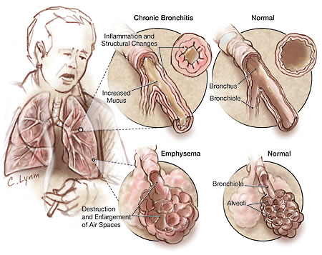

Slide 43
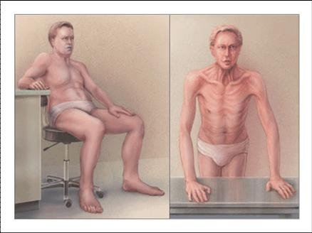
The COPD patient

Slide 44
Obesity Hypoventilation Syndrome (OHS)
aka “Pickwickian Syndrome”
Increase in CO₂ during sleep (>10 mmHg)
Presence of hypoventilation during wakefulness (PaCO₂ >45 mmHg) as measured by arterial PCO₂, end-tidal PCO₂, or transcutaneous PCO₂
BMI >30 kg/m²
No other reason for hypoventilation such as neuromuscular disease, restrictive thoracic disease, obstructive lung disease or interstitial lung disease
Notes:
Retains CO₂
The majority of OHS patients have comorbid OSA (80% to 90%).
Hypercapnia (PaCO₂ >45 mmHg) must be present during wakefulness. Where arterial blood gases are difficult to obtain, arterialized-venous blood sampling can be used as a valid surrogate for pH, PCO₂, and bicarbonate.
Hypoxemia (PaO₂ <70 mmHg) is usually present. The calculated alveolar-arterial (A-a) oxygen gradient may be normal in patients with OHS. A widened A-a gradient may indicate co-existent lung or heart disease.

Slide 45
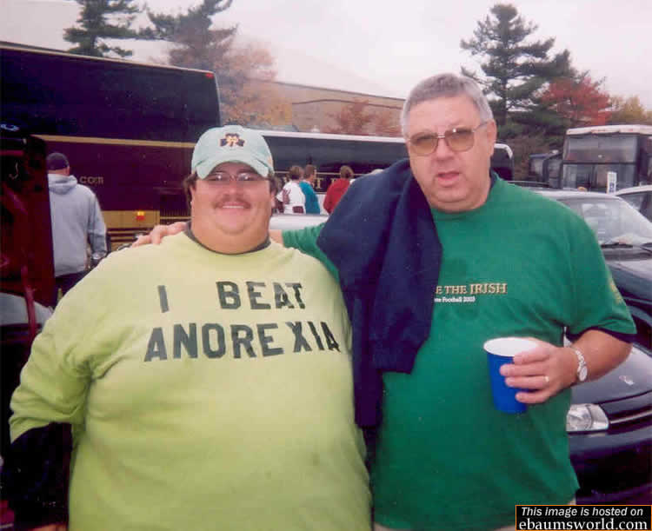

Slide 46
Neuromuscular Disease
Progressive muscle weakness that increases over time
Patient cannot ventilate adequately
Examples: ALS, multiple sclerosis, myasthenia gravis
NIV required to help patient ventilate
Retains CO₂

Slide 47
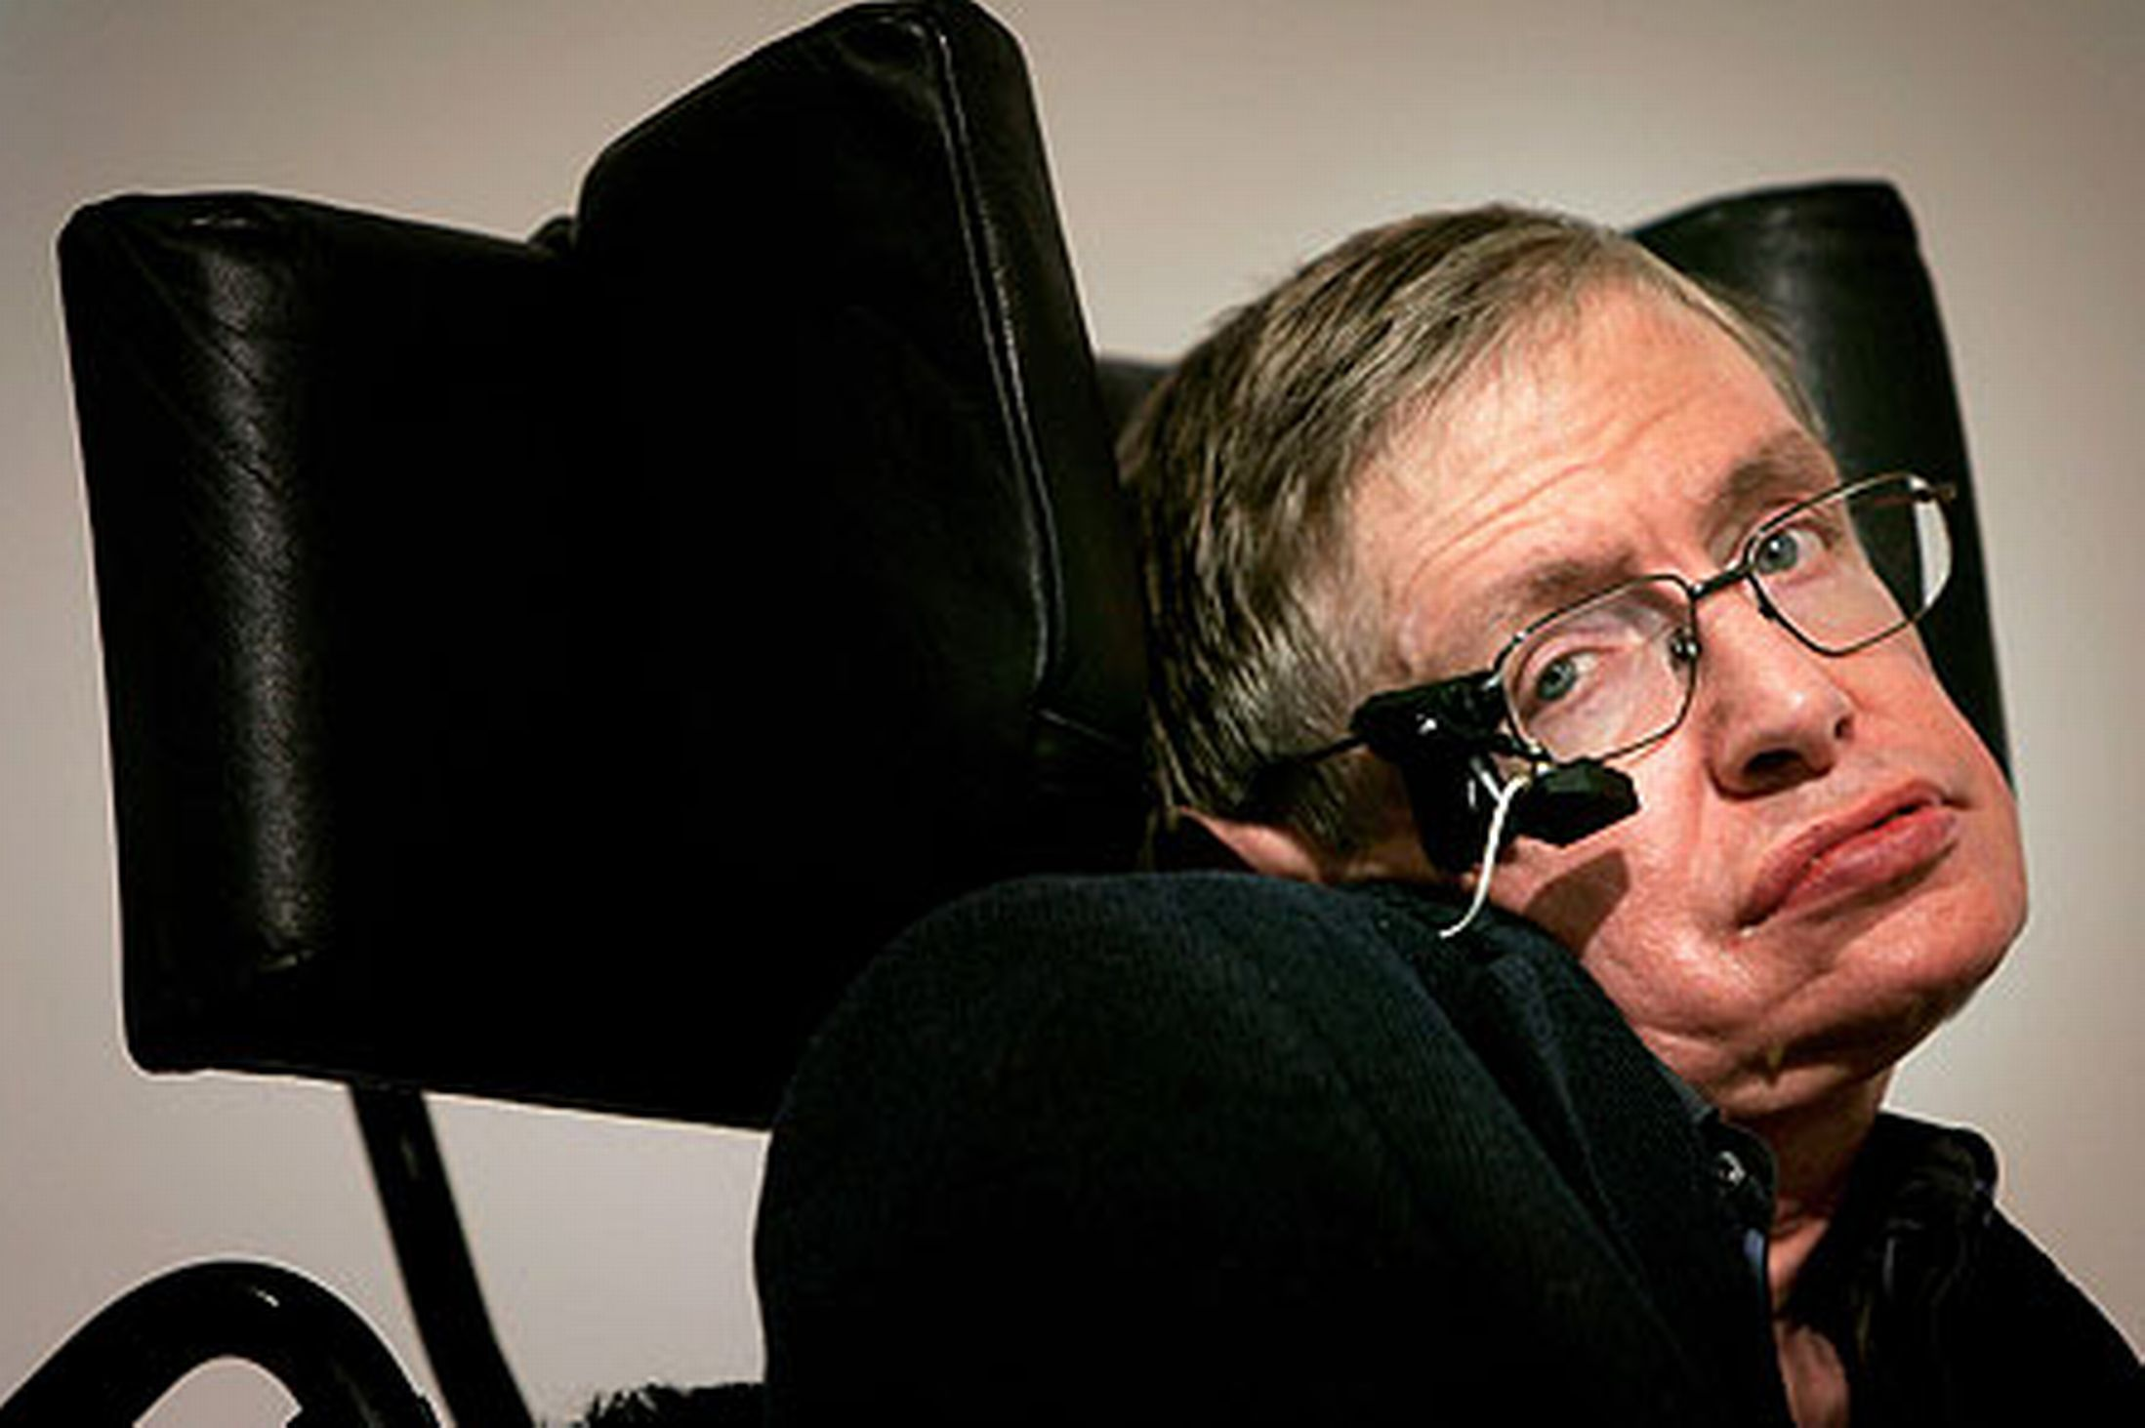


Slide 48



Slide 49
The Challenge
Neuromuscular Disorders
  Patient’s respiratory capabilities decline as the disease progresses (e.g. ALS)
  With standard bi-level therapy, a patient’s tidal volume declines
Restrictive Thoracic Disorder
  Chest wall deformities (e.g. kyphoscoliosis)
  Slow progressive disease
Obesity Hypo-ventilation Syndrome
  A change in body position increases airway resistance
  Without an increase in pressure support, the patient tidal volume declines

Slide 50
Clinical Benefits of AVAPS
Guarantee of ventilatory support during progressive ventilatory changes of the patient
Guarantee of ventilatory support during positional changes during sleep
Provides the assurance of a tidal volume within a bilevel system
Alarms to indicate that tidal volume is not being maintained

Slide 51
Clinical Studies
CHEST Sept 2006 (Storre et all)
  Obesity hypoventilation patients
  PtcCO₂ decreased significantly during nocturnal BiPAP AVAPS
ERS Poster Presentation 2004 (Clini et all)
  COPD patients
  PaCO₂ on AVAPS was 48 after one hour as compared to 53 on S mode
  RR on AVAPS was 18 after one hour as compared to 20 on S mode
  Statistical significant in VAS scores was shown with AVAPS
Notes:
Physician like new technology but they also want to have proof that it has benefits for their patients. We are lucky because AVAPS has been available internationally for the past 2 years and we have some studies that were done by in Europe that show positive outcome data. Lets look at some of those studies that you will be able to share with your physicians.

Slide 52
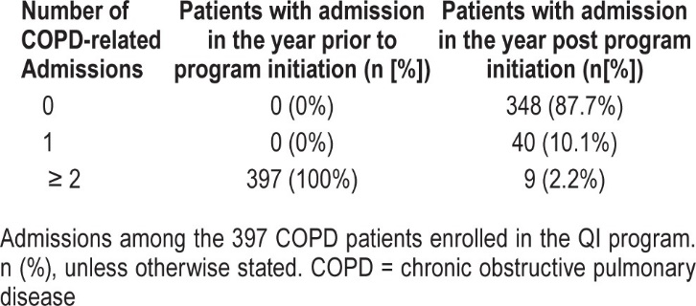
Hospital readmissions following initiation of quality improvement program
J Clin Sleep Med. 2015 Jun 15; 11(6): 663–670.
Notes:
(a) Medication reconciliation was performed by a pharmacist at the time of hospital discharge.
(b) Oxygen Therapy: Due to the severity of their COPD, most patients had been initiated on either nocturnal or 24-h oxygen therapy by their hospital physician prior to their enrollment into the QI program. Those patients who had not received oxygen were given a prescription if they had oxygen saturation ≤ 88% at rest.
(c) All patients were placed on AVAPS-AE (using Trilogy 100, Philips Respironics, Inc. Monroeville, PA), or switched from CPAP or bilevel PAP therapy to AVAPS-AE, using a target tidal volume V_{T} mode. AVAPS-AE can automatically titrate expiratory positive airway pressure (EPAP) to treat obstructive events of OSA if present; automatically adjust pressure support (PS) to achieve a physician-defined target tidal volume, based on ideal body weight (set at 5–7 mL/Kg IBW); and maximize expiratory time to help avoid breath-stacking by adjusting the back-up rate based on the patient's spontaneous rate. The device was set with EPAP range from a minimum of 5 cm H₂O (EPAPmin) to a maximum of 15 cm H₂O (EPAP-max); PS range from a minimum of 2 cm H₂O (PSmin) to a maximum of 26 cm H₂O (PSmax); automatic back-up rate and entrained with oxygen based upon the wakefulness determination through a t-connector and oxygen concentrator. Mask fitting and therapy initiation were done by an RT either at the hospital prior to discharge, or, if the referral was not received in time before discharge by a home medical company at the patient's home.
(d) Education: Patient education was delivered during initiation of AVAPS-AE by an RT either at the hospital prior to discharge, or, if the referral was not received in time by the homecare company, at the patient's home within a week of discharge. The session took between 90 and 100 minutes and covered education about COPD and available treatments, breathing techniques, and techniques to clear mucus from the lungs; patients were also provided with an educational booklet with such information for future reference (Barnes Healthy at HomeTM booklet).
(e) Respiratory therapist led care was delivered in the patients' homes. Patients were visited by the respiratory therapist twice during the first week and 6 times during the first 30 days after initiation of AVAPS-AE therapy. Subsequently, patients received monthly visits up to day 90 and visits every 3 months thereafter. Unplanned visits where scheduled at the request of the patient. Each visit took 30–45 minutes and focused on maximizing patient adherence to medications and AVAPS-AE therapy by providing information regarding the benefits of treatments and information on how to administer medications and use their NIPPV device. Additionally, patients were encouraged to quit smoking if they were active smokers. Patients were encouraged to use their NIPPV device ≥ 4 h/night on all nights. Changes to prescriptions were made following consultation with the patient's referring physician. Readmission to the hospital in the 12 months following the initiation of the QI program was retrospectively obtained by extracting information from patient charts.

Slide 53
Titration Protocol

Slide 54
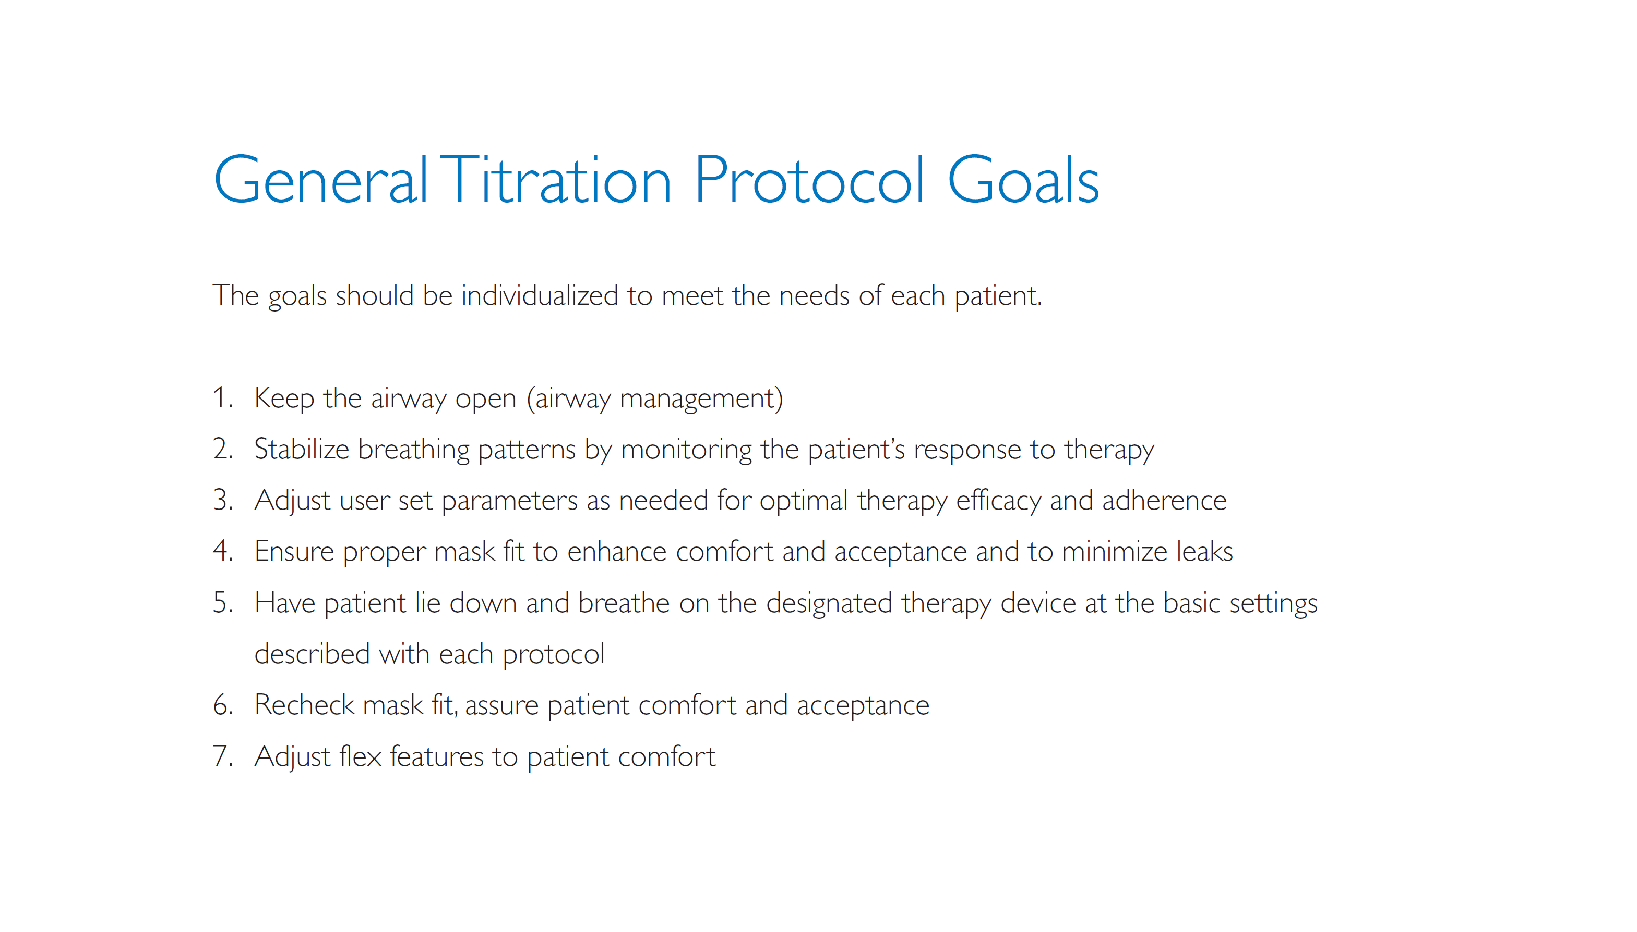

Slide 55
What Settings Can Be Adjusted In AVAPS?
Tidal volume
Rate
Rise time
Inspiratory time
EPAP
IPAP_{min}
IPAP_{max}

Slide 56
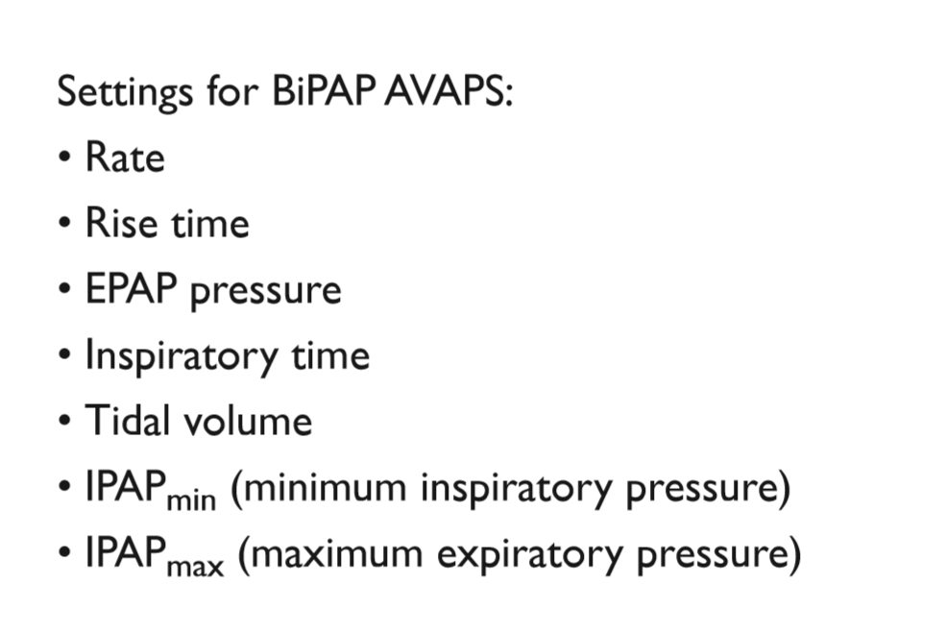
CPAP treats obstruction, keeps airway patent
Pressure
Support

Slide 57
What is the Initial Tidal Volume?
Patient is a 49 year old male with morbid obesity and hypoventilation. His height is 1.55 m (5’1’’), weight 127 kg (280 lbs), BMI 53, ideal body weight 55 kg. Order is written to start at 10 cc/kg. What is the starting tidal volume that you start this patient on???
400 mL
450 mL
500 mL
550 mL
600 mL
1270 mL
Don’t know, call MD in middle of the night

Slide 58
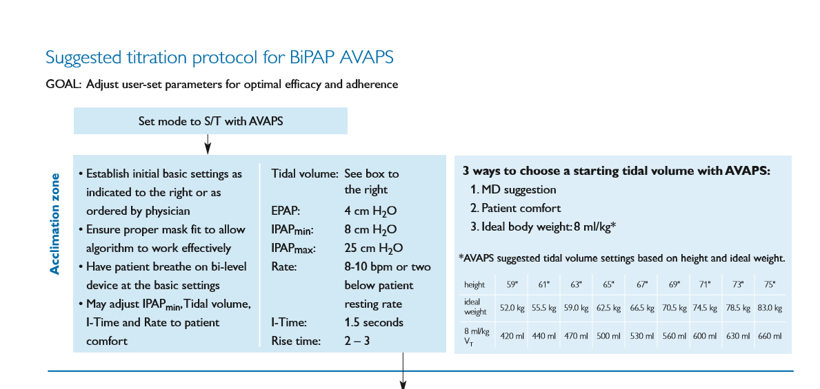

Slide 59
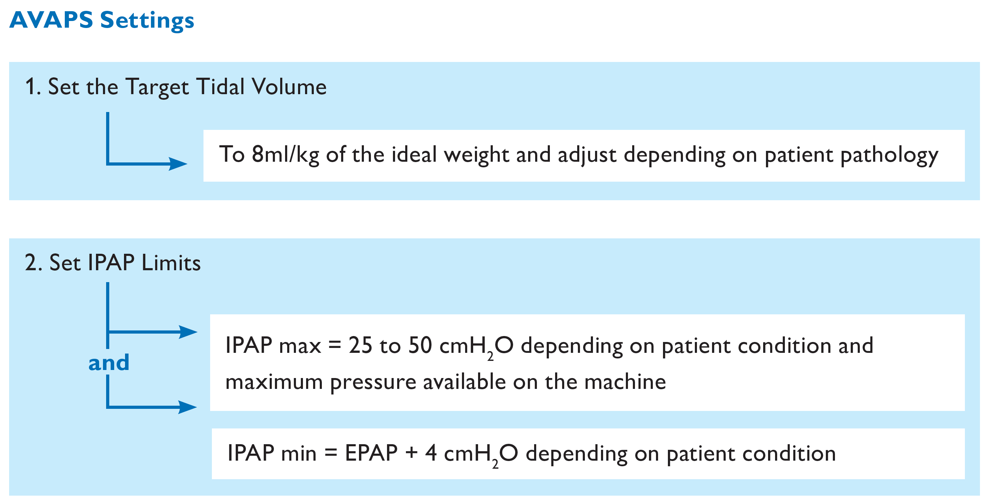

Slide 60
AVAPS-AE suggested settings
 | OHS* | COPD – OSA*
Vt Target | 8 -10 ml/Kg of ideal bodyweight | 5-8 ml/Kg of ideal bodyweight
Max P | 40 cmH2O | 40 cmH20
PS Max | 19- 35 cmH2O | 30 cmH2O
PS Min | 4 cmH2O | 8 cmH2O
EPAP Max | 14 cmH20 | 14 cmH2O
EPAP Min | 4 cmH2O | 4 cmH2O
Breath Rate | Auto | Auto
AVAPS Rate | 5 | 5
* AVAPS-AE protocol Dr. N. Hart, Dr. P. Murphy, Lane Fox Respiratory unit, St. Thomas’ Hospital London UK
* AVAPS-AE Multi Center Trial protocol l,Prof Jean François MUIR, France
Notes:
Preliminary suggested AVAPS-AE settings related to the published abstracts and trials performed during pre-launch and after launch of AVAPS-AE mode .
* COPD-OSA AVAPS-AE protocol Dr. N. Hart, Dr. P. Murphy, Lane Fox Respiratory unit, St. Thomas’ Hospital London UK (COPD)
* OHS AVAPS-AE Multi Center Trial protocol l (OHS), Prof. Dr. Jean François MUIR (MCT France in process)
Final setting guidelines will be adapted and corrected after the Multi Centre Trial results in France

Slide 61
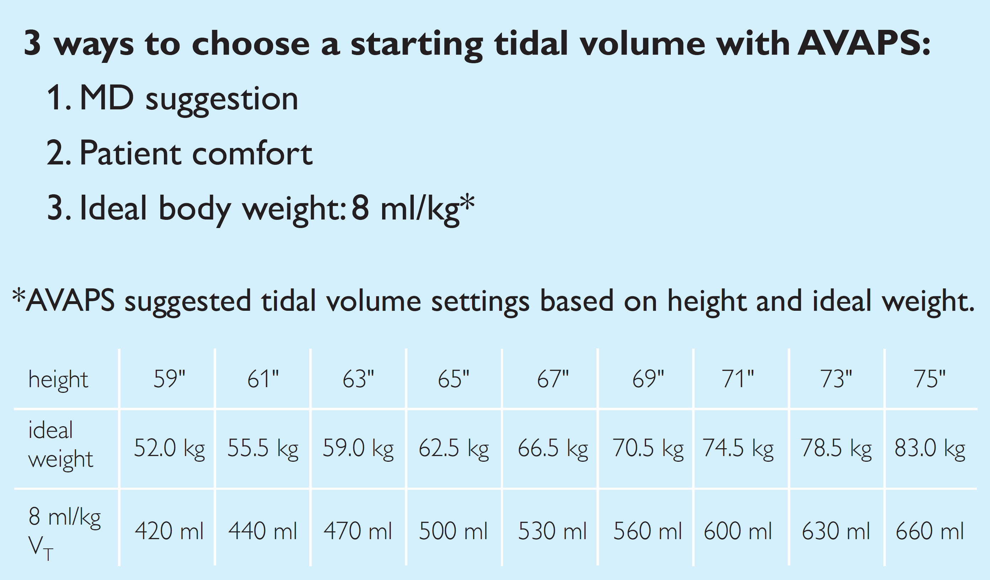

Slide 62
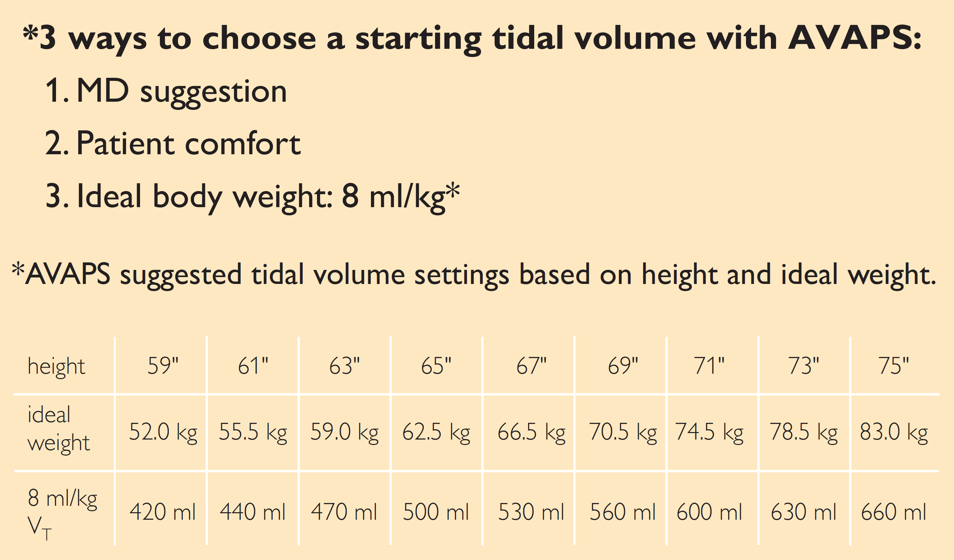

Slide 63
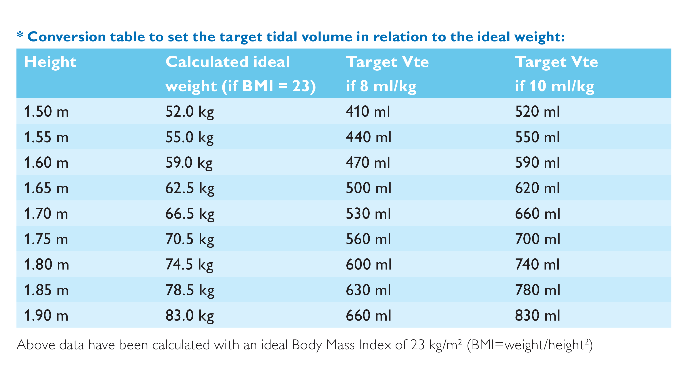

Slide 64

Ideal Body Weight Chart: Males
Height | Calculated Ideal Body Weight | Target V_{T} 8 mL/kg | Target V_{T} 10 mL/kg | Target V_{T} 12mL/kg
60 in / 152 cm | 50.0 kg | 400 mL | 500 mL | 600 mL
62 in / 157 cm | 54.6 kg | 440 mL | 550 mL | 660 mL
64 in / 163 cm | 59.2 kg | 470 mL | 590 mL | 710 mL
65 in / 165 cm | 61.5 kg | 490 mL | 620 mL | 740 mL
66 in / 168 cm | 63.8 kg | 500 mL | 640 mL | 770 mL
67 in / 170 cm | 66.1 kg | 530 mL | 660 mL | 790 mL
68 in / 173 cm | 68.4 kg | 550 mL | 680 mL | 820 mL
69 in / 175 cm | 70.7 kg | 570 mL | 710 mL | 820 mL
70 in / 178 cm | 73.0 kg | 580 mL | 730 mL | 850 mL
71 in / 180 cm | 75.3 kg | 600 mL | 750 mL | 900 mL
72 in / 183 cm | 77.6 kg | 620 mL | 780 mL | 930 mL
74 in / 188 cm | 82.2 kg | 660 mL | 820 mL | 990 mL
76 in / 193 cm | 86.8 kg | 700 mL | 870 mL | 1040 mL
Ideal Body Weight Reference:
Merck Manual “Critical Care Medicine: Respiratory Failure and Mechanical Ventilation”

Slide 65

Ideal Body Weight Chart: Females
Height | Calculated Ideal Body Weight | Target V_{T} 8 mL/kg | Target V_{T} 10 mL/kg | Target V_{T} 12mL/kg
58 in / 147 cm | 40.9 kg | 400 mL | 410 mL | 490 mL
59 in / 150 cm | 43.2 kg | 440 mL | 430 mL | 520 mL
60 in / 152 cm | 45.5 kg | 470 mL | 460 mL | 550 mL
61 in / 155 cm | 47.8 kg | 490 mL | 480 mL | 570 mL
62 in / 157 cm | 50.1 kg | 500 mL | 500 mL | 600 mL
63 in / 160 cm | 52.4 kg | 530 mL | 520 mL | 630 mL
64 in / 163 cm | 54.7 kg | 550 mL | 550 mL | 660 mL
65 in / 165 cm | 57.0 kg | 570 mL | 570 mL | 680 mL
66 in / 168 cm | 59.3 kg | 580 mL | 590 mL | 710 mL
67 in / 170 cm | 61.6 kg | 600 mL | 620 mL | 740 mL
68 in / 173 cm | 63.9 kg | 620 mL | 640 mL | 770 mL
69 in / 175 cm | 66.2 kg | 660 mL | 660 mL | 790 mL
70 in / 178 cm | 68.5 kg | 700 mL | 690 mL | 820 mL
Ideal Body Weight Reference:
Merck Manual “Critical Care Medicine: Respiratory Failure and Mechanical Ventilation”

Slide 66
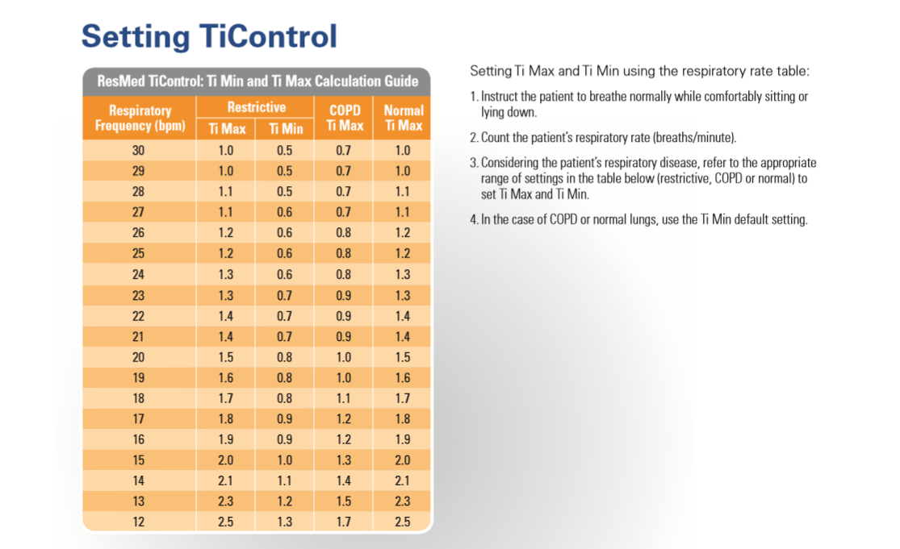

Slide 67
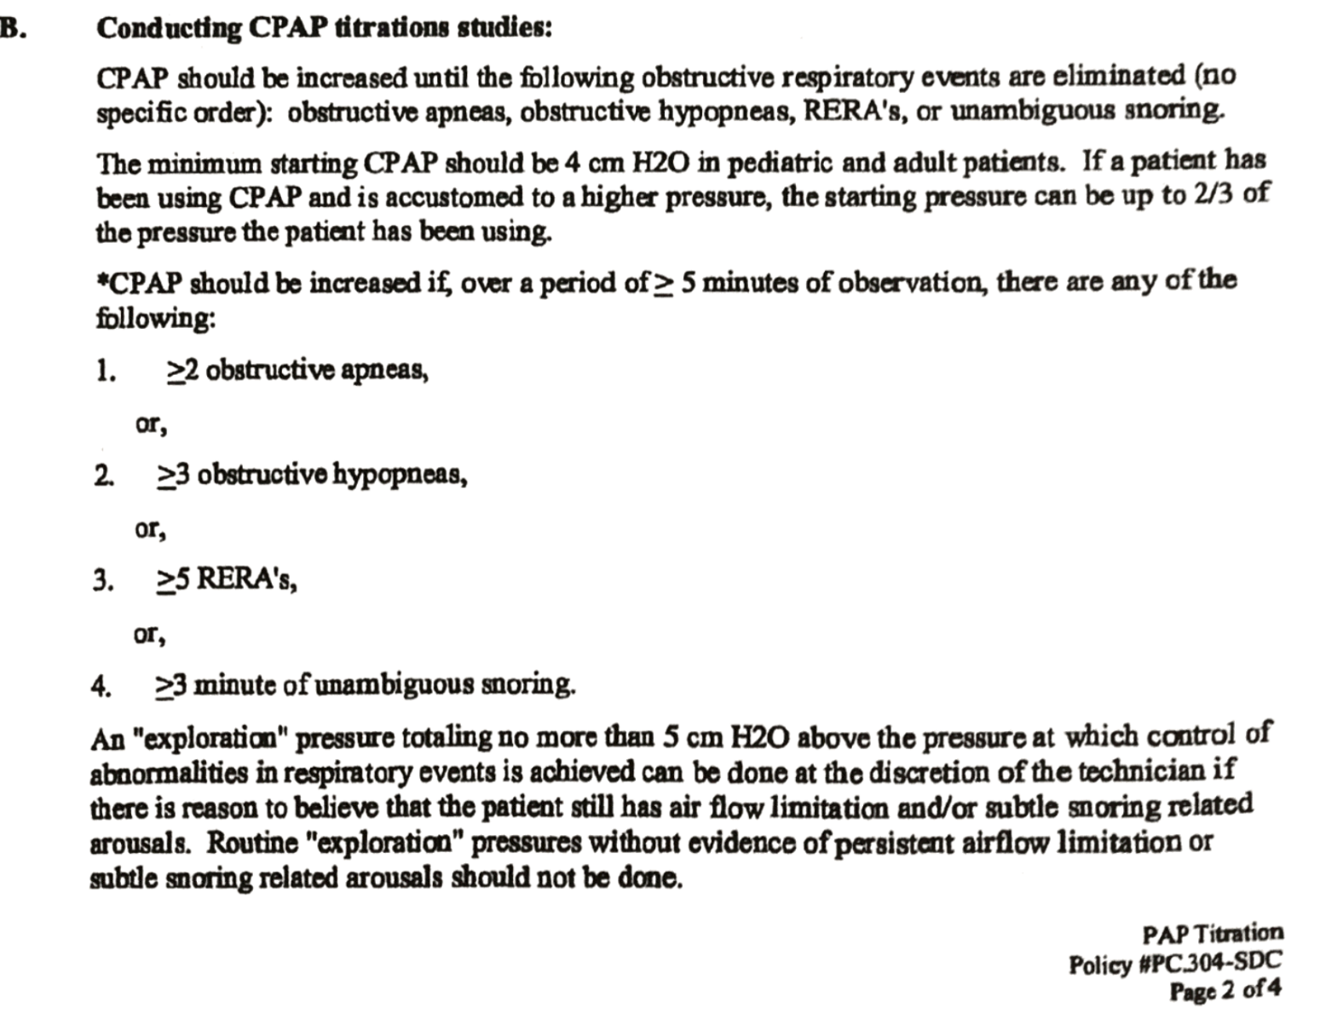

Slide 68
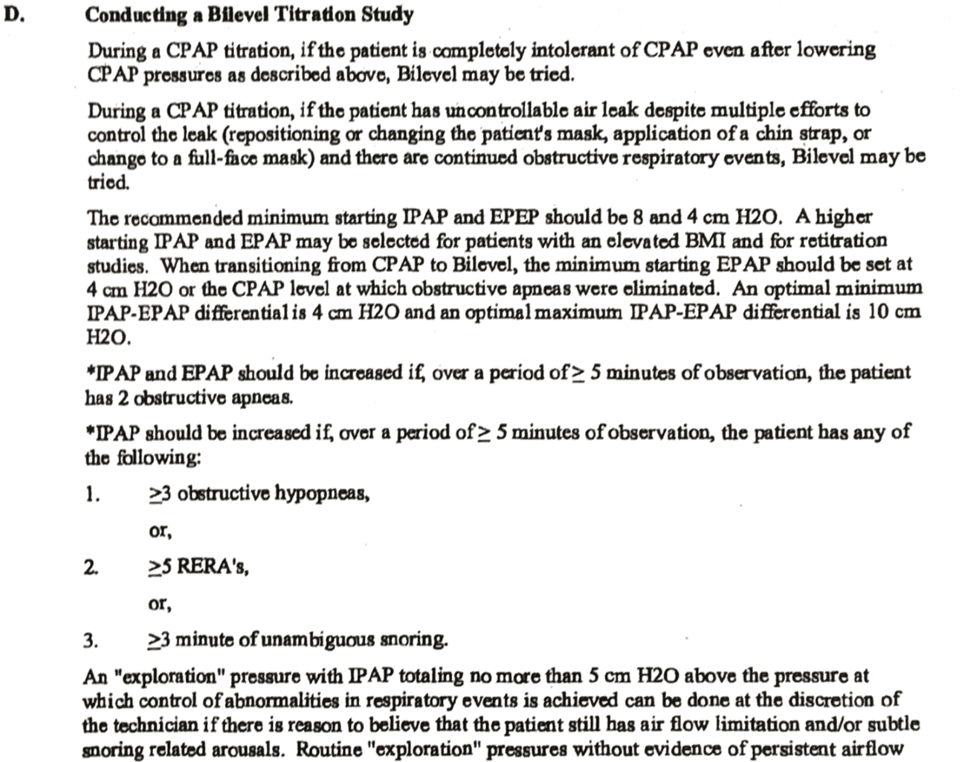

Slide 69
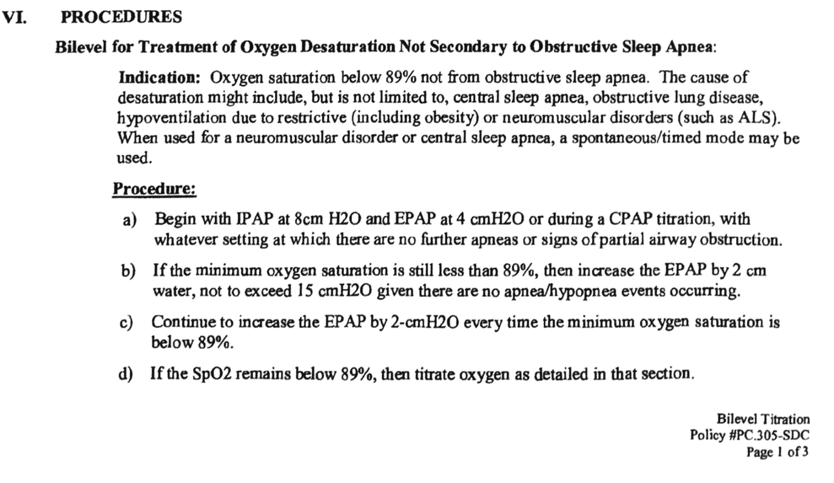

Slide 70
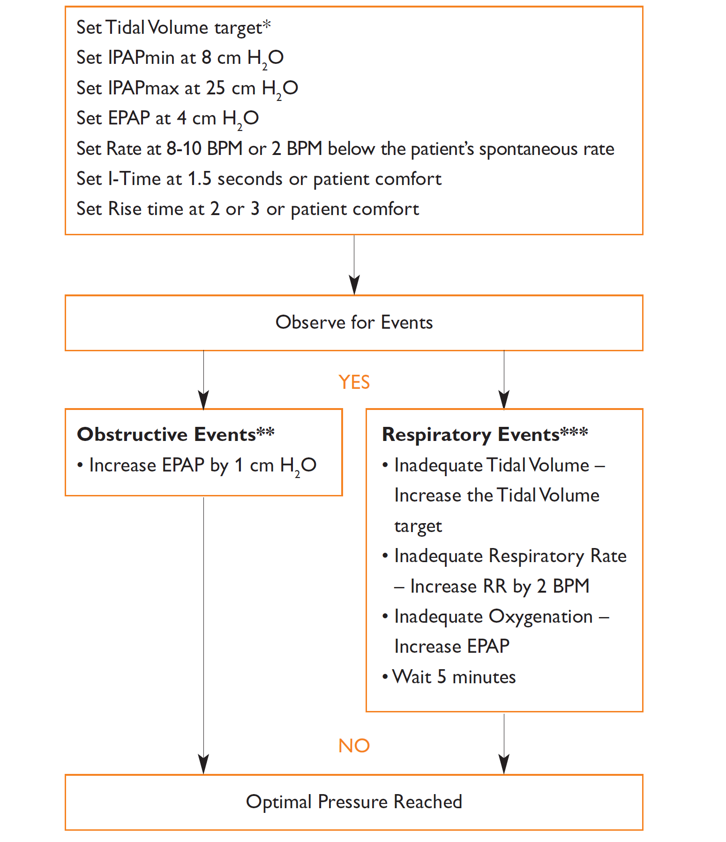





Slide 71


Slide 72


Slide 73


Slide 74


Slide 75


Slide 76
Troubleshooting

Slide 77


Slide 78


Slide 79


Slide 80


Slide 81


Slide 82


Slide 83
AVAPS is NOT recommended for patients with periodic breathing
Treatment of periodic breathing requires a variable breath by breath response system so the patients PaCO₂ stabilizes quickly
  Prevents overshooting or undershooting the PaCO₂ breath by breath
  Does not augment the patient’s tidal volume consistently
AVAPS is does not have a quick variable response to changes in tidal volume
  Designed to adjust and maintain a constant tidal volume with each breath over time
  This benefit often seen with patients who have slow declines in their ventilatory conditions
Notes:
AVAPS is NOT recommended for patients who have periodic breathing. Treatment of the periodic breathing patterns requires a different form of therapy called Servo Ventilation provided by the BiPAP autoSV Advanced. Periodic breathing requires a system which will quickly adjust breath by breath by either augmenting only selected breaths which may fall below their normal flow pattern. This allows the patient to stabilize their PaCO₂ and prevents the bodies responding hyperventilation due to periodic hypoventilation.
AVAPS does not have a quick response time in changing the patients tidal volume (increase of 1 cm H₂O per min) and is best suited for patients who have slow changes in tidal volumes through out the night on a consistent basis versus a periodic basis.

Slide 84
Why not use volume assured pressure support for Periodic Breathing such as Cheyne Stokes?
Volume assurance with PS does not respond fast enough – event would be over before reaching needed pressure
Length of event vs. time of response

Slide 85

Take Home Points
Tidal volume based off of ideal body weight (calculated from height)
Wait… watch… observe… think… patience is key
Titrate EPAP for obstructive events (don’t forget about IPAP_{min})
IPAP_{min} ≥ 4 cmH₂O above EPAP
Max P = EPAP + IPAP max
Monitor for hypoventilation (CO₂ levels)
Adjust TV, RR, rise time for patient comfort
Consider adding oxygen only after reaching optimal PS and RR
Must control leak!

Slide 86
Acknowledgements
Philips Respironics for slide content
Jodi Kahlenbeck

Slide 87

Questions???

