Slide 1
Sleep and the
Developmentally Disabled
Advocating for Success
Ned Barnes, RPSGT, RST, CCSH
Blanchard Valley Hospital
Sak Sleep Wellness Center

Slide 2
Sleep and… the Developmentally Disabled
Objectives:
--Overview of… The Psychosocial Living Conditions of the DD
--Elements of successful treatment of OSA for the DD
--Challenges of successful treatment of OSA for the DD
--A call action…to help those who need our help most

Slide 3
Sleep and… the Developmentally Disabled
Disclosures:
None that I know of
I’m just a small town Sleep Tech that mostly does night Sleep Studies…

Slide 4

Sleep and…the Developmentally Disabled
Case Scenario…
Dan…

Slide 5
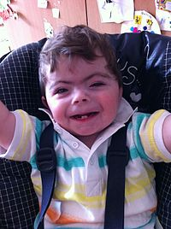
Sleep and…the Developmentally Disabled
Case Scenario…
Dan Age 29-38…
Disability: Unknown – probably Cornelia de Lange Syndrome (CdLS)…
--The phenotype is highly varied and thus is described as a
spectrum; from Classic CdLS (with a greater presence of key
features) to Mild CdLS.
--Long Thick Eyebrows
--Cleft Palate
--Hearing Impairment
--Chronic Respiratory Illness
--Heart Defects (coarctation of the aorta) *
--Facial Dysmorphology
--GERD
--Seizures
--Muscoskeletal Problems

Slide 6
Sleep and…the Developmentally Disabled
Case Scenario…
Dan Age 29-38…
1st In-Lab PSG (unanticipated Split Night)…
--Severe OSA with significant SpO2 Desats
--Apneas > 60 seconds
--Very Loud (gasping) Snores

Slide 7
Sleep and…the Developmentally Disabled
Case Scenario…
Dan Age 29-38…
Initial CPAP Therapy:
--Traditional (non-auto) CPAP
--Non-Compliance in first 120 days
--Dan typically removed mask in sleep… (no one there to help)
--Lost CPAP eqiupment… failure to comply with CMS guidelines
--Untreated OSA grew worse

Slide 8
Sleep and…the Developmentally Disabled
Case Scenario…
Dan Age 29-38…
2nd In-Lab PSG (unanticipated Split Night)…
--Severe OSA with significant SpO2 Desats
--Apneas > 60 seconds
--Very Loud (gasping) Snores
--Weight and overall health issues had increased--

Slide 9
Sleep and…the Developmentally Disabled
Case Scenario…
Dan Age 29-38…
Second CPAP Therapy
--Auto CPAP (10.0 cm – 15.0 cm EPR 3)
--Better (not perfect) compliance
--Able (barely) to fulfill CMS minimum compliance (kept CPAP)
--Still removed mask in his sleep at times
--Very restless sleep (Hose often smashed and unusable)
--Tried hard for better compliance… but only 4-5 hours a night
--Overall health deteriorated (BMI increase, HTN less controlled)
--Severe respiratory failure noted in Seizure-like episode (4/2018)

Slide 10
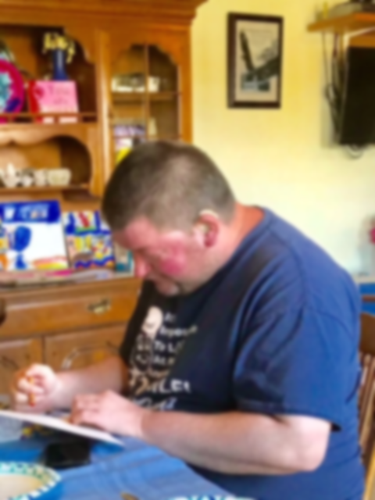
Sleep and…the Developmentally Disabled
Case Scenario…
Dan Age 29-38…
Age 38 (May 2018)…
--Sudden death
(likely massive coronary incident)

Slide 11
Sleep and…the Developmentally Disabled
Case Scenario…
Dan …
Post mortem considerations…
--Staff reduction just prior to 1st CPAP Therapy
--Inflexibility (likely due to lack of timely info) of the Sleep Physician
--CPAP equipment issues…In spite of ongoing help from two Sleep
Techs (personal friends able to help acquiring equipment)

Slide 12
Sleep and…the Developmentally Disabled
Case Scenario…
Dan …
Post mortem considerations…
--Staff reduction just prior to 1st CPAP Therapy
--Inflexibility (likely due to lack of timely info) of the Sleep Physician
--CPAP equipment issues…In spite of ongoing help from two Sleep
Techs (personal friends able to help acquiring equipment)
The Challenge

Slide 13
Sleep and…the Developmentally Disabled
In-Lab Patient Care Flow:
--Initial Consult with Sleep Physician (or Direct Referral)
--In-Lab PSG
--Follow up Physician Visit
--CPAP Titration
--DME
--CPAP Therapy Follow up Visits with Sleep Physician

Slide 14
Sleep and…the Developmentally Disabled
In-Lab Patient Care Flow:
--Initial Consult with Sleep Physician (or Direct Referral)
--In-Lab PSG
--Follow up Physician Visit
--CPAP Titration
--DME
--CPAP Therapy Follow up Visits with Sleep Physician
Long term Success with CPAP available to all???

Slide 15
Sleep and…the Developmentally Disabled
Psychosocial Living Conditions of the DD:
--Guardianship (living with or - oversight of living - by family)
--State Oversight of / and Assistance with “Independent” living…

Slide 16
Sleep and…the Developmentally Disabled
Psychosocial Living Conditions of the DD:
--Guardianship (living with or oversight of living by family)
--Children with DD >= 18 years old (Guardianship)
--Legal ability to have a say in your DD child’s life

Slide 17
Sleep and…the Developmentally Disabled
Psychosocial Living Conditions of the DD:
--Guardianship (living with or oversight of living by family)
--Children with DD >= 18 years old (Guardianship)
--Legal ability to have a say in your DD child’s life
--Individual Service Plan (ISP)… [With County Board of DD]
--Service Providers (Companies and now Individual)
--Individual or Group Adult Assisted Living
--Vocational and Avocational options
--Respite Services

Slide 18
Sleep and…the Developmentally Disabled
Psychosocial Living Conditions of the DD:
--Guardianship (living with or oversight of living by family)
--Children with DD >= 18 years old (Guardianship)
--Legal ability to have a say in your DD child’s life
--Individual Service Plan (ISP)… [With County Board of DD]
--Service Providers (Companies and now Individual)
--Individual or Group Adult Assisted Living
--Vocational and Avocational options
--Respite Services
--Funding:
--SSI and eventually SSDI
--Medicaid and eventually Medicare/Medicaid
--Home and Community-Based Waivers
--County Board of DD Levy Funding

Slide 19
Sleep and…the Developmentally Disabled
Psychosocial Living Conditions of the DD:
--State Oversight of / and Assistance with “Independent” living…
County Board of DD [Service Support Administrator (SSA)]

Slide 20
Sleep and…the Developmentally Disabled
Psychosocial Living Conditions of the DD:
--State Oversight of / and Assistance with “Independent” living…
County Board of DD [Service Support Administrator (SSA)]
--Individual Service Plan (ISP)
--Service Providers (Companies and now Individual)
--Individual or Group Adult Assisted Living
--Vocational and Avocational options
--Individual Daily Rep assistance (volunteer advocates)

Slide 21
Sleep and…the Developmentally Disabled
Psychosocial Living Conditions of the DD:
--State Oversight of / and Assistance with “Independent” living…
County Board of DD [Service Support Administrator (SSA)]
--Individual Service Plan (ISP)
--Service Providers (Companies and now Individual)
--Individual or Group Adult Assisted Living
--Vocational and Avocational options
--Individual Daily Rep assistance (volunteer advocates)
--Funding:
--SSI and eventually SSDI
--Medicaid and eventually Medicare/Medicaid
--Home and Community-Based Waivers
--County Board of DD Levy Funding

Slide 22
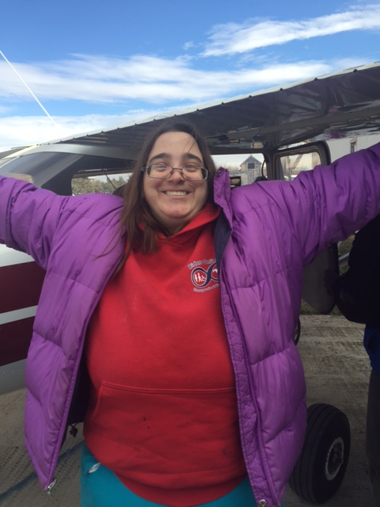
Sleep and…the Developmentally Disabled
Case Scenario…
Allison Barnes… [Guardianship] Living at home with family
Disability: Wiedemann-Steiner Syndrome
--A rare genetic disorder that causes developmental delay…
--Short Stature
--Unique facial features
--Hairy Arms (“Hairy Arms Syndrome”)
--Hypotonia in Joints
--Feeding and Digestive Complexities (feeding tubes in early years)
--Dental Issues (TMJ, etc…)
--Cognitive Issues (esp. memory, sequencing, organization)
--OCD
--Immune System Issues

Slide 23
Sleep and…the Developmentally Disabled
Case Scenario…
Allison Barnes… [Guardianship] Living at home with family
In-Lab PSG
--Mild OSA with Moderate SpO2 Desats
--Sinal Pauses
--UAR (occasional loud gasping snores)

Slide 24
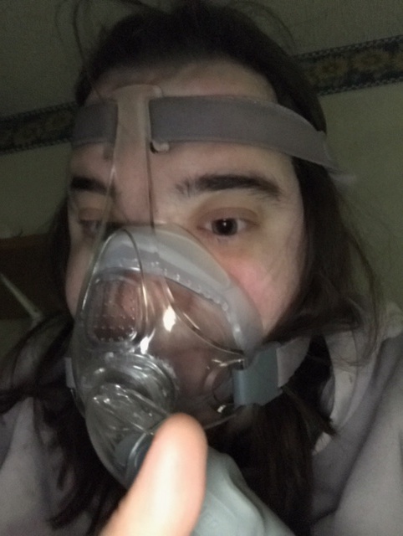
Sleep and…the Developmentally Disabled
Case Scenario…
Allison Barnes… [Guardianship]
CPAP Therapy
--Auto-CPAP (8.0cm – 15.0cm)
--Near 100% Compliance (once she felt the benefit)
--Improved Cognitive Function
--Decreased EDS
--Improved ability to ‘stay well’

Slide 25
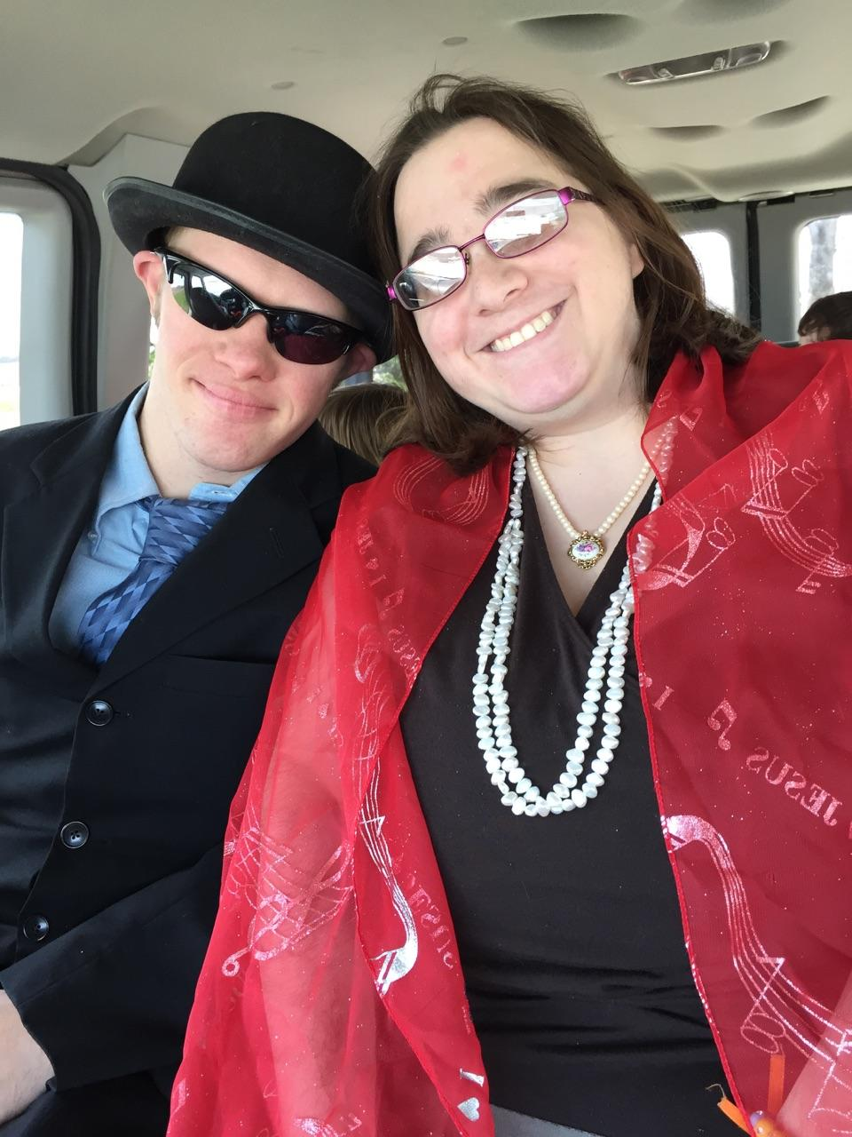
Sleep and…the Developmentally Disabled
Case Scenario…
Allison Barnes… [Guardianship]
CPAP Therapy (now after 5 years)
--Auto-CPAP (8.0cm – 16.0cm)
--Near 100% Compliance
--Integral to her overall health and quality of life
Alli is the oldest Female with WSS identified in America

Slide 26
Sleep and…the Developmentally Disabled
Case Scenario…
Allison Barnes… [Guardianship]
Successful treatment of OSA attributable to strong family support

Slide 27
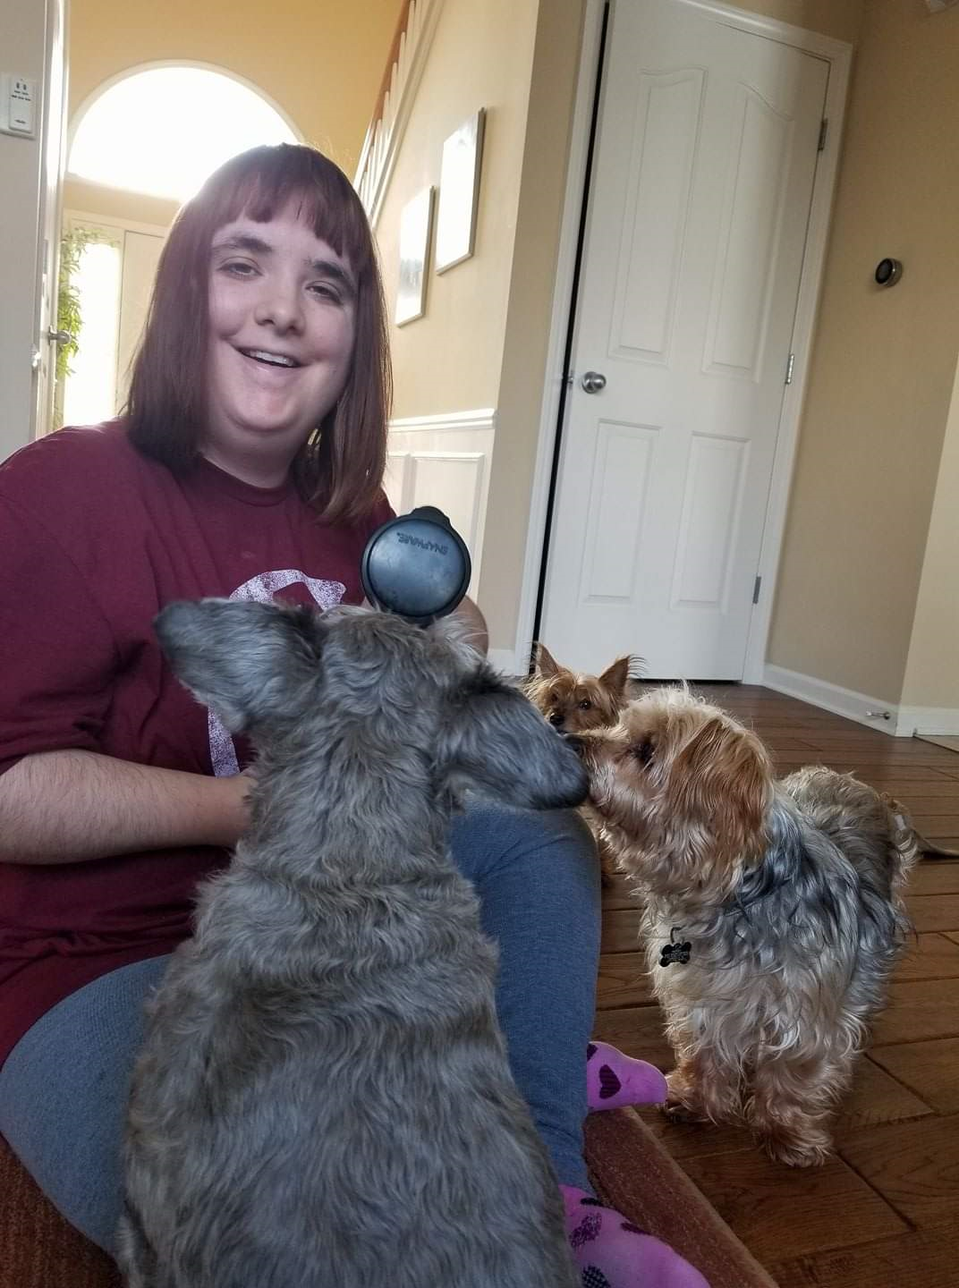
Sleep and…the Developmentally Disabled
Case Scenario…
Jenne’… [Guardianship]… Living Independently with Service Staff
Disability: Wiedemann-Steiner Syndrome
--A rare genetic disorder that causes developmental delay…
--Short Stature
--Unique facial features
--Hairy Arms (“Hairy Arms Syndrome”)
--Hypotonia in Joints
--Feeding and Digestive Complexities (feeding tubes in early years)
--Dental Issues (TMJ, etc…)
--Cognitive Issues (esp. memory, sequencing, organization)
--OCD
--Immune System Issues

Slide 28
Sleep and…the Developmentally Disabled
Case Scenario…
Jenne’… [Guardianship]… Living Independently with Service Staff
Total of 4 Sleep Studies…
--1st…In-Lab PSG (Severe OSA)
--Treated with T&A Surgery
--2nd… In-Lab Split Night (Mild to Moderate OSA)
--Treated with CPAP (Unresolved Mild to Moderate OSA)
--3rd… PSG with MSLT (Narcolepsy diagnosed)
--Treated with medication (discontinued r/t side affects)
--4th… HST (showed positional OSA)
--Currently treating with Positional Therapy

Slide 29
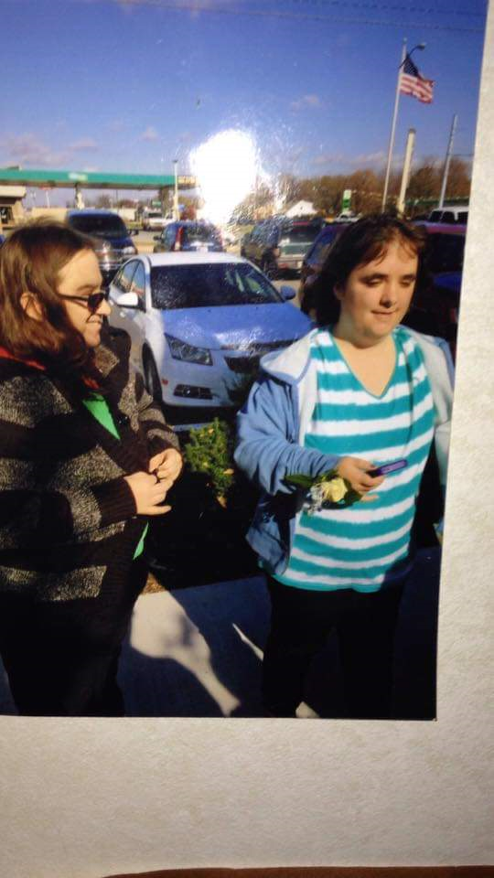
Sleep and…the Developmentally Disabled
Case Scenario…
Jenne’… [Guardianship]…
Sleep issues not fully resolved…
--Continued EDS
(with moodiness and behaviors, HTN, DM)
--Family involvement crucial to
all improvements gained

Slide 30
Sleep and…the Developmentally Disabled
Case Scenario…
Tracy (13 year old girl)… [Minor living with parents]
Disability: Prader-Willi Syndrome (PWS)
--A rare complex genetic disorder affecting appetite, growth, metabolism, cognitive function and behavior.
--Short Stature…
--Cognitive disabilities...
--Behavioral problems…
--Slowed Metabolism…
**Chronic feelings of insatiable hunger**

Slide 31
Sleep and…the Developmentally Disabled
Case Scenario…
Tracy (13 year old girl)… [Minor living with parents]
In-Lab PSG…
--1:1 care – in addition to having Mother in room all night…
--Continual behavioral outbursts prompted by PSG equipment…
--Required ongoing ‘coaching’ by mother to keep wires on…
--Very limited consolidated sleep – due to irrational fears…

Slide 32
Sleep and…the Developmentally Disabled
Case Scenario…
Tracy (13 year old girl)… [Minor living with parents]
In-Lab PSG Results…
--AHI: 9 (14 – Supine… 25 – REM)…
Challenge:
--In-Lab CPAP Titration (not possible) due to fear and behaviors…
--CMS guidelines do not allow Auto-Titration…
--Tracy even terrified to attend consult with Dr. Sak.

Slide 33
Sleep and…the Developmentally Disabled
Case Scenario…
Tracy (13 year old girl)… [Minor living with parents]
Solution:
--Dr. Sak appealed CMS for a home Auto Tiration (peer review)…
--Home Auto Titration was granted…
--Prescribed Therapy: Auto CPAP (5.0cm – 10.0cm)

Slide 34
Sleep and…the Developmentally Disabled
Case Scenario…
Tracy (14 year old girl)… [Minor living with parents]
Compliance:
--1st 30 day (100% compliance)
--Median Pressure: 9.4 (95th percentile 10.0 cm)
--AHI: 1.2

Slide 35
Sleep and…the Developmentally Disabled
Case Scenario…
Tracy (14 year old girl)…
[Minor living with parents]

Slide 36
Sleep and…the Developmentally Disabled
Case Scenario…
Tracy (14 year old girl)…
[Minor living with parents]
Success due to:
--Dr. Sak’s successful appeal for Auto-Titration
--Good Family support

Slide 37
Sleep and…the Developmentally Disabled
Psychosocial Living Conditions of the DD:
--State Oversight of / and Assistance with “Independent” living…
County Board of DD [Service & Support Administrator (SSA)]

Slide 38
Sleep and…the Developmentally Disabled
Case Scenario…
James (65 year old man)… [State Oversight (SSA) in Group AL Home with 24/7 staff]
Disability: Autism Spectrum
--High functioning in communication and 1:1 interaction
--Very unsure about prospect of PSG (and possibility of using CPAP Mask)
--High ESS (falling asleep daily at Workshop and Day Hab)

Slide 39
Sleep and…the Developmentally Disabled
Case Scenario…
James (65 year old man)… [State Oversight (SSA) in Group AL Home with 24/7 staff]
In-Lab PSG…
--1:1 Care
--Lots of reassurance required
--Staff (House Manager) coached Tech on Pt sensativities
--Provisional Mask Trial (taking time to encourage and answer questions)
--Goal: to have fun positive night for James

Slide 40
Sleep and…the Developmentally Disabled
Case Scenario…
James (65 year old man)… [State Oversight (SSA) in Group AL Home with 24/7 staff]
In-Lab PSG Results: (Severe OSA)…
--AHI 43 (74 in Supine)
--Severe SpO2 Desats

Slide 41
Sleep and…the Developmentally Disabled
Case Scenario…
James (65 year old man)… [State Oversight (SSA) in Group AL Home with 24/7 staff]
In-Lab CPAP Titration…
--Took extra time in Mask Trial (He liked being like Darth Vader – to match his Vader Pants)
--Lots of Tech “Cheerleading”
--James had fun… and decided CPAP would be fun at home

Slide 42
Sleep and…the Developmentally Disabled
Case Scenario…
James (65 year old man)… [State Oversight (SSA) in Group AL Home with 24/7 staff]
In-Lab CPAP Titration Results…
--Supine REM with no OSA noted @ CPAP of 11.0 cm/H20
--Supine N3 Rebound
--James felt rested and refreshed and energetic (very unusual for him)

Slide 43
Sleep and…the Developmentally Disabled
Case Scenario…
James (65 year old man)… [State Oversight (SSA) in Group AL Home with 24/7 staff]
In-Lab CPAP Titration Results…
--Supine REM with no OSA noted @ CPAP of 11.0 cm/H20
--Supine N3 Rebound
--James felt rested and refreshed and energetic (very unusual for him)
--Educated Staff (House Manager)… on CPAP Compliance
--Verified James had Staff 24/7 (i.e. night supervision to help with using mask)
--Final “Cheerleading” on how good James felt after using CPAP (in front of Staff)
--Staff picked up on “cheerleading” in terms James understood…

Slide 44
Sleep and…the Developmentally Disabled
Case Scenario…
Dori (38 year old woman)… [State Oversight (SSA) in Group AL Home with 24/7 staff]
Disability: Unspecified DD, Schizophrenia, Multiple Esophageal Surgeries
--High functioning in communication and 1:1 interaction
--High Anxiety regarding PSG wires and possible CPAP Mask use
--Loud Snoring and Witnessed Apneas by Staff (and in Hospital)
--GERD, Depression, Morbid Obesity (BMI 49)

Slide 45
Sleep and…the Developmentally Disabled
Case Scenario…
Dori (38 year old woman)… [State Oversight (SSA) in Group AL Home with 24/7 staff]
In-Lab PSG (turned into Split Night) Results:
--AHI > 85 by epoch 260
--Significant SpO2 Desats
--Split Night indicated and initiated
--REM Rebound with no OSA noted @ 12.0 cm/H2O
--Mask and CPAP Tolerated well
--Dori felt better in morning that she normally feels

Slide 46
Sleep and…the Developmentally Disabled
Case Scenario…
Dori (38 year old woman)… [State Oversight (SSA) in Group AL Home with 24/7 staff]
In-Lab PSG (turned into Split Night) Results:
--AHI > 85 by epoch 260
--Significant SpO2 Desats
--Split Night indicated and initiated
--REM Rebound with no OSA noted @ 12.0 cm/H2O
--Mask and CPAP Tolerated well
--Dori felt better in morning that she normally feels
--Recognized probability of Split Night Titration
--Education and mask trial geared to ‘stress-free’ needs of Dori
--”Cheerleading” all night (geared to Dori’s sensativities)
--Educated Service Provider (at time of Pickup in morning)

Slide 47
Sleep and…the Developmentally Disabled
Psychosocial Living Conditions of the DD:
--State Oversight of / and Assistance with “Independent” living…
County Board of DD Service [ Support Administrator (SSA)]
Challenges

Slide 48
Sleep and…the Developmentally Disabled
Service and Support Administrator (SSA) Perspective:
Jennifer M. Sandusky County, OH SSA
--CPAP Protocol:
--Itemized in Individual Service Plan (ISP)
--ISP specifies CPAP Compliance as well as all Sleep Physician appts
--All Service Providers encouraged to be creative in encouraging CPAP
--ISP will continue to include CPAP even if Consumer habitually refuses CPAP Compliance

Slide 49
Sleep and…the Developmentally Disabled
Service and Support Administrator (SSA) Perspective:
Jennifer M. Sandusky County, OH SSA
--CPAP Protocol:
--Itemized in Individual Service Plan (ISP)
--ISP specifies CPAP Compliance as well as all Sleep Physician appts
--All Service Providers encouraged to be creative in encouraging CPAP
--ISP will continue to include CPAP even if Consumer habitually refuses CPAP Compliance
--State Waiver Funding reductions have eliminated overnight supervision for many
Consumers
--Many Counties now promoting “Remote Monitoring” (Alexa units, Echo units, Computer that prompt and remind, Internet Cameras, Remote Lock Downs, etc…)
--Problem: “Remote Monitoring” is not capable of putting a CPAP mask back on…

Slide 50
Sleep and…the Developmentally Disabled
Service Provider Perspective:
Maria B.
--former house manager with Service Company in Hancock & Seneca Counties, OH
--CPAP Protocol:
--CPAP listed on M.A.R.
--Staff required to encourage CPAP and record usage (just like Meds)
--Attendance to Sleep Physician appointments accommodated
--Overnight Staff members monitor CPAP compliance
--Staff trained in “creative encouragement” of consumers to use CPAP
--Consumer has right to refuse CPAP use (a right under Ohio Law)

Slide 51
Sleep and…the Developmentally Disabled
Service Provider Perspective:
Maria B.
--former house manager with Service Company in Hancock & Seneca Counties, OH
--CPAP Protocol:
--CPAP listed on M.A.R.
--Staff required to encourage CPAP and record usage (just like Meds)
--Attendance to Sleep Physician appointments accommodated
--Overnight Staff members monitor CPAP compliance
--Staff trained in “creative encouragement” of consumers to use CPAP
--Consumer has right to refuse CPAP use (a right under Ohio Law)
--Challenges:
--Struggle to find Balance between Consumer Right to Refuse and Medical Necessity
--Inconsistent Staff effort in “creative encouragement” (i.e. apathy in some staff)
--Funding cuts (in Waivers) that ended overnight supervision for many consumer

Slide 52
Sleep and…the Developmentally Disabled
Service Provider Perspective:
Maria B.
--former house manager with Service Company in Hancock & Seneca Counties, OH
Case Scenario:
--29 year old female consumer (no parents involved)
--Autistic, Dwarfism, Mental Disability
--Severe OSA (CPAP prescribed and used)
--Maria was house manager and provided overnight supervision
--Consumer was thriving in sheltered workshop, and Day-Hab programs

Slide 53
Sleep and…the Developmentally Disabled
Service Provider Perspective:
Maria B.
--former house manager with Service Company in Hancock & Seneca Counties, OH
Case Scenario:
--29 year old female consumer (no parents involved)
--Autistic, Dwarfism, Mental Disability
--Severe OSA (CPAP prescribed and used)
--Maria was house manager and provided overnight supervision
--Consumer was thriving in sheltered workshop, and Day-Hab programs
--Waiver Funding cuts (overnight staff supervision discontinued)
--CPAP non-Compliance emerged with lack of overnight staff
--Onset of Behaviors at Workshop and in Day-Hab
--Loss of Workshop job and had incident requiring police intervention

Slide 54
Sleep and…the Developmentally Disabled
Summary of our Advocacy:
CCSH Credential Holders should be good at this…
DOMAIN 3: PATIENT AND FAMILY COMMUNICATION AND EDUCATION 30%
TASK A: Provide education to patient and family 10-13%
i.Respond to questions
ii.Recognize the importance of diversity
iii.Evaluate readiness to learn at an age appropriate level
iv.Adapt interactions to learning styles

Slide 55
Sleep and…the Developmentally Disabled
Summary of our Advocacy:
Assess the DD Patient and Living conditions:
--Living in Family home (under Guardianship or as a Minor)
--Living independently (In Adult AL or individually) [under Guardianship]
--Living in Adult AL with State Oversight (SSA); Service Staff assisting 24/7
--Living in Adult AL with State Oversight (SSA); Remote Monitored (minimal Staff)

Slide 56
Sleep and…the Developmentally Disabled
Summary of our Advocacy:
Assess the DD Patient abilities and sensitivities:
--Determine how best to communicate Sleep Education info to them
--Be careful to not frustrate or overwhelm
--”Cheerleading” at every available opportunity
--Make the In-Lab visit as fun and comfortable as possible (positive experience)

Slide 57
Sleep and…the Developmentally Disabled
Summary of our Advocacy:
Assess the DD Patient’s most viable advocate (as much as possible):
--Support Staff member (in rare occasions…SSA)
--Parent / Guardian (other involved family member)
--Educate and equip the Patient’s best advocate with all they need to promote long
term PAP compliance and good sleep health

Slide 58
Sleep and…the Developmentally Disabled
Summary of our Advocacy:
Communicate within your Sleep Facility for DD Patient’s benefit:
--Be sure Sleep Physician knows any concerns you may have regarding DD Patient’s
successful PAP therapy.
--Always communicate pertinent Clinical info that affects DD Patient’s outcomes

Slide 59
Sleep and…the Developmentally Disabled
Summary of our Advocacy:
…Be Ready to Help those who need our help most…

Slide 60
Sleep and the
Developmentally Disabled
Advocating for Success
Ned Barnes, RPSGT, RST, CCSH
Blanchard Valley Hospital
Sak Sleep Wellness Center
nedaphor@gmail.com

